Slide 1
This slideshow comes with presenter notes,
where we explain what’s going on as the images
roll by.
If you don’t see the Notes pane or it is completely
minimized, click Notes on the task bar across the
bottom of the PowerPoint window.
Try it! We’ve added notes to this slide so you can
see if you’re set up correctly.
Notes:
Can you see these notes? Excellent! If you’re having trouble — or if you want to view the notes on one monitor, while you use another to project the slideshow — you should probably Google something like “show presenter notes in PowerPoint” and study the suggested technique.

Slide 2
Notes:
Welcome! This presentation is aimed at writers, editors and designers. As it evolved over the years, I kept adding and deleting the page examples you’ll see, but I always kept the runtime around 45 minutes. This version, however, is much longer, with many more examples. This way, you can select what to keep and what to delete.

Slide 3
Notes:
Before we begin, a question: What’s our goal, when we publish a story? Do we do it for fame and fortune? For the big bucks? To make the world a better place?
How do you measure success?
For me — prepare to be disappointed — it always comes down to one word: Eyeballs.

Slide 4
Notes:
Yes, eyeballs. I want as many eyeballs as possible on my stuff. For as long as possible, too.

Slide 5
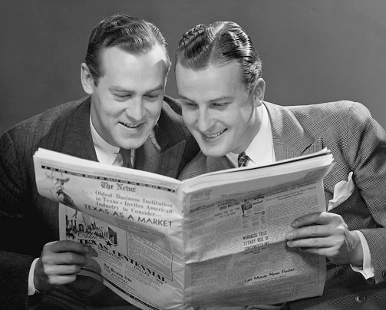
Notes:
That sounds selfish, I know. But it’s really not. . . .

Slide 6
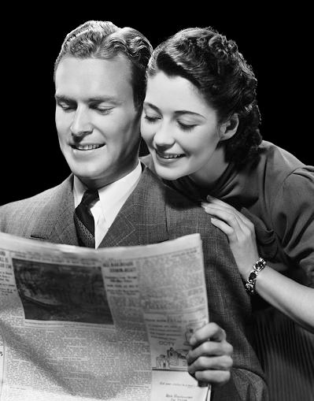
Notes:
. . . . because it’s a competitive media market out there, whatever platform you’re working on. TV and radio broadcasts live and die based on ratings — the number of eyeballs (or ears) they attract. For websites, it’s the number of clicks.

Slide 7
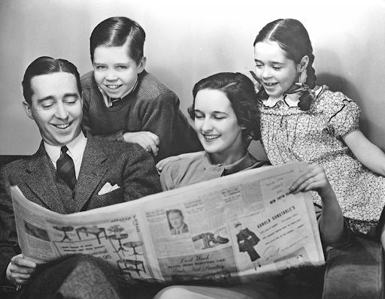
Notes:
Is there anything sadder than a beautifully written news story, on an important topic, that dies because it’s lost amidst the media maze, becoming . . . . . invisible?

Slide 8
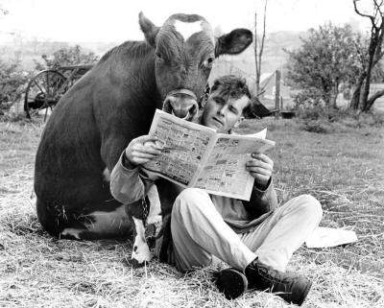
Notes:
So, as I used to tell my students: Pretend you agree with me. How do you attract readers in the most dependably effective way?

Slide 9
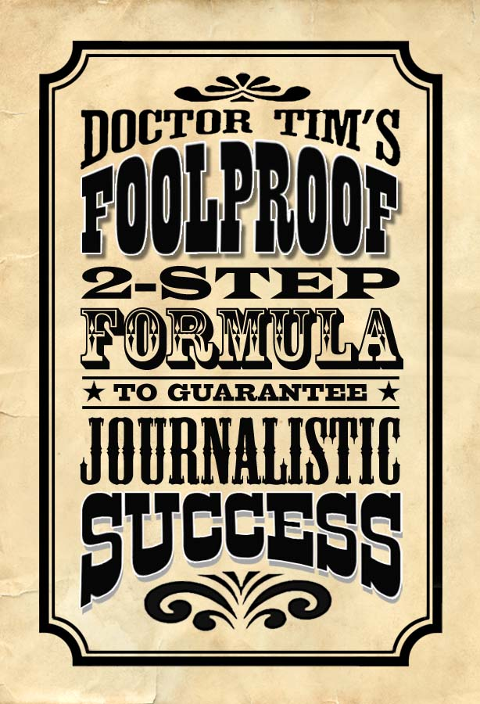

Slide 10
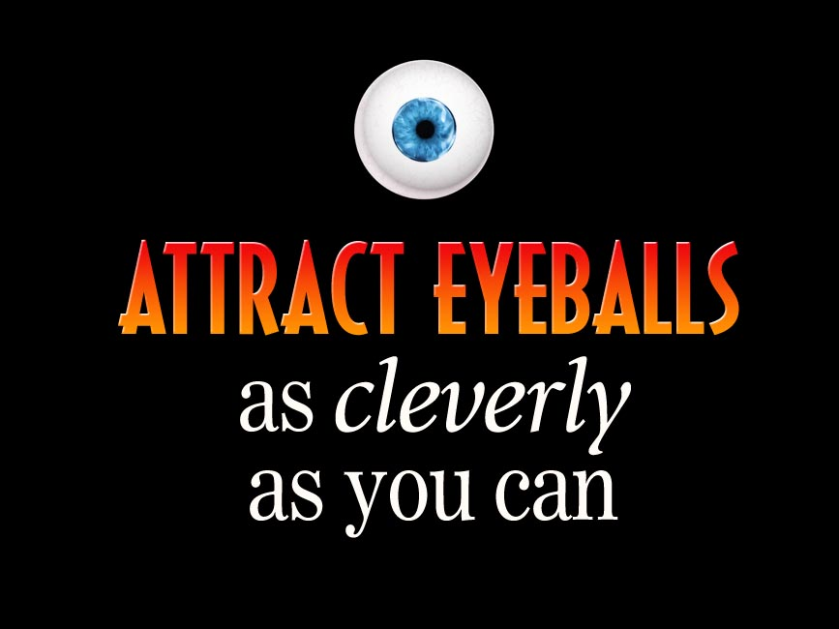

Slide 12
Notes:
OK, Step One. Let’s think about this. What does it take to attract the eyeballs of a typical modern reader?

Slide 13
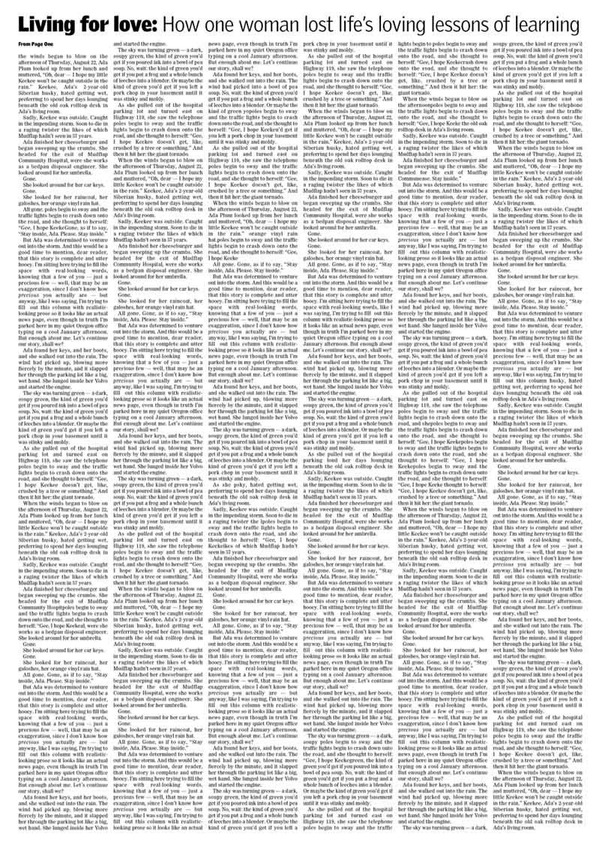
Notes:
How about a page like this? Hey, wait! Come back! There’s some terrific journalism here!

Slide 14
Notes:
Or even a story like this. Important stuff, sure — but to a typical reader, it looks more like this . . .

Slide 15
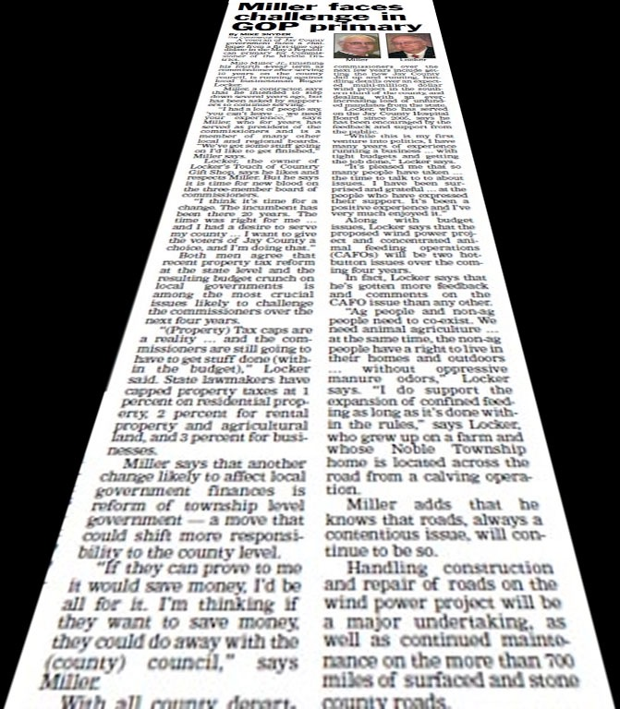
Notes:
. . . . a tough, uphill slog. Just the layout alone — all that serious, gray text — looks daunting, regardless of how well-written the story may be.

Slide 16
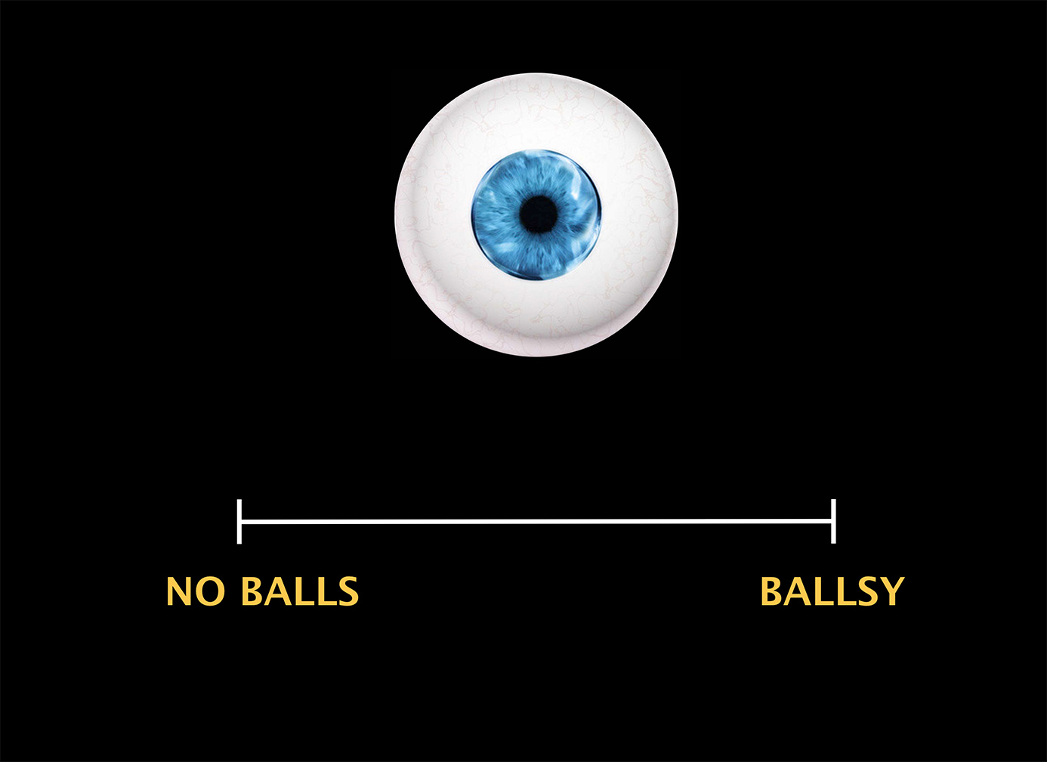
Text
Notes:
Think about your own publication. How much eyeball appeal do the stories offer, on a scale from weak to strong — from “NO BALLS” to “BALLSY”?
So how do you go about attracting eyeballs in a clever way? Let’s look at some examples. . . .

Slide 17
Notes:
This may be the most arresting magazine cover of all time. Forced you to engage, didn’t it? (Sure it’s tasteless, but it’s appropriate for a humor magazine.)

Slide 18
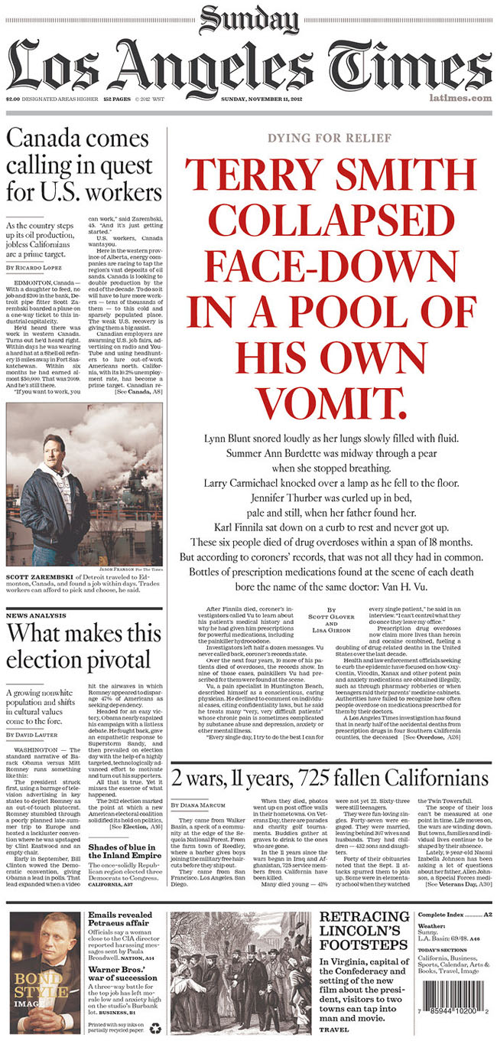
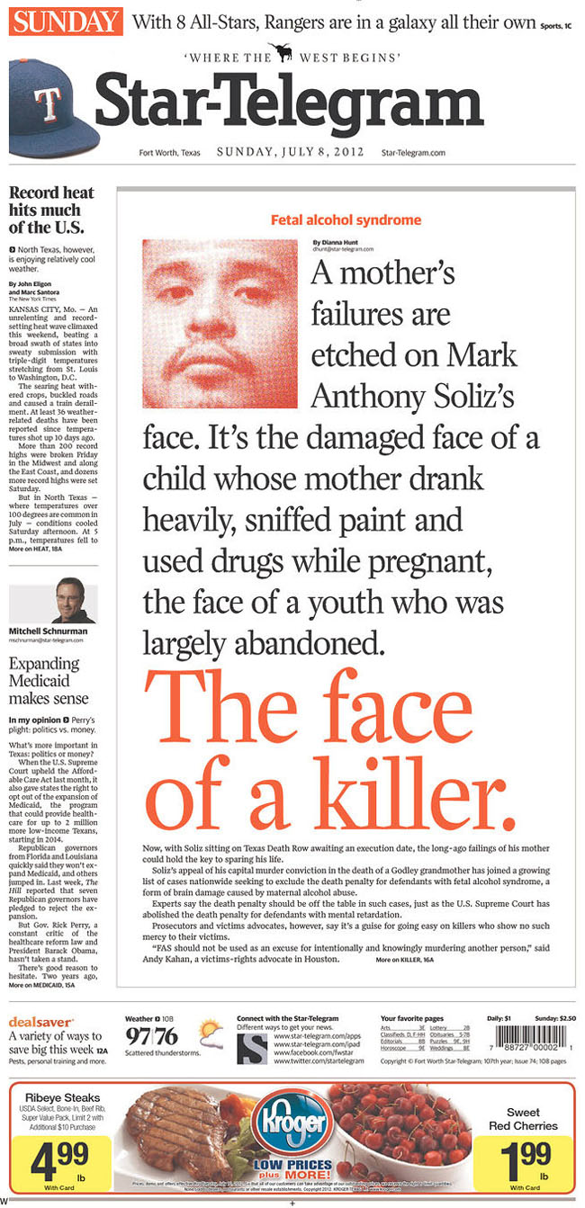
Notes:
This big, bold, red headline has enormous stopping power. Designers call this a “type attack”: using aggressive typography to sell a big story when you’ve got no dramatic photos. Too sensational? At first, you might think so. But once you’ve read all that oversized type, don’t you want to keep reading?

Slide 19
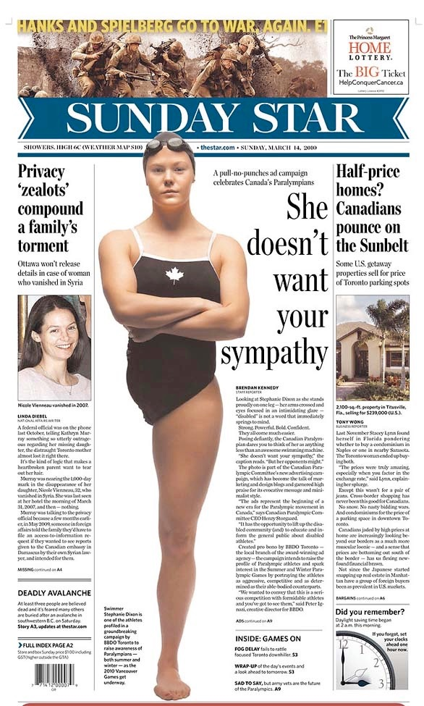
Notes:
Talk about dramatic photos! Once you see this image (and the compelling headline), how can you not at least sample what the text is saying?

Slide 20
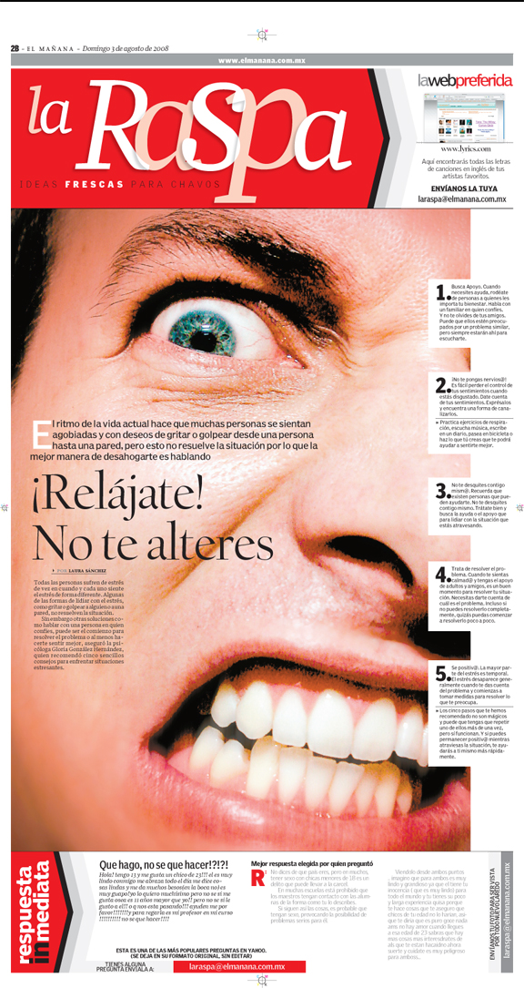
Notes:
“Relax! Don’t get excited.” The confrontational crop on this photo is unusually aggressive. And the layout makes this look like an easy read.

Slide 21
Notes:
Again, on this page, it’s not just the extreme size and cropping of the photo — it’s the way the layout provides a variety of accessible entry points to lure you in.

Slide 22
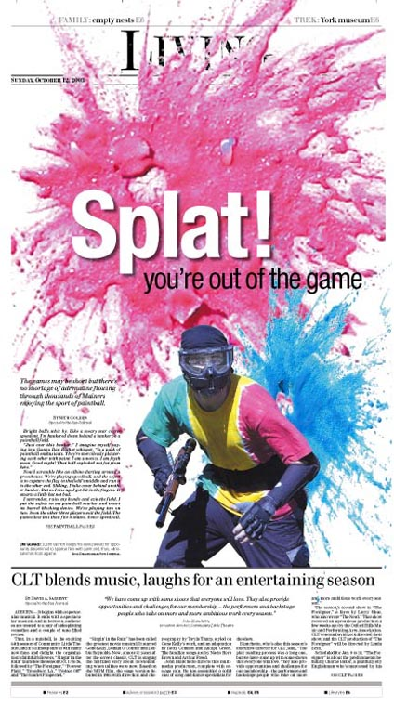
Notes:
Here, a big, messy headline does the job of grabbing your attention.

Slide 23
Notes:
Tilting type and photos can be gimmicky, but it’s effective with the right topic (usually feature stories).

Slide 24
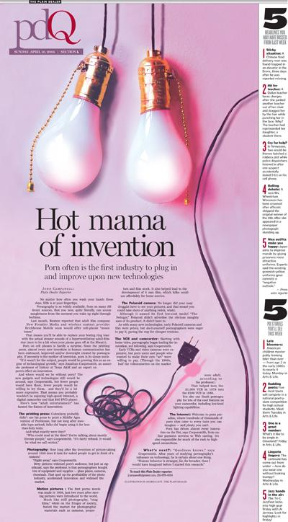
Notes:
Just how daring are you willing to be? This story about porn and technology tested the tolerance of readers in Cleveland.

Slide 25
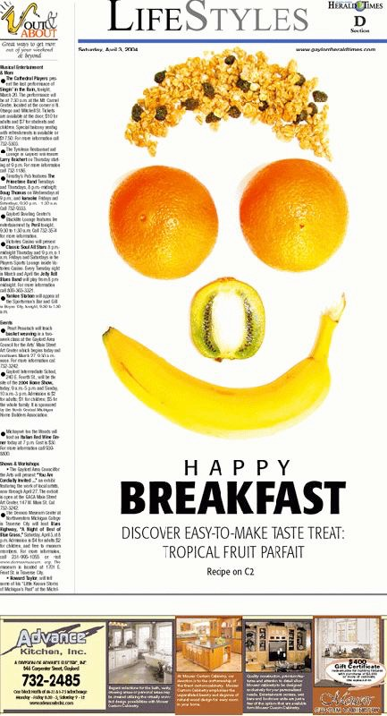
Notes:
Fun with fruit! You can arrange your fruit to form a happy face . . . . .

Slide 26
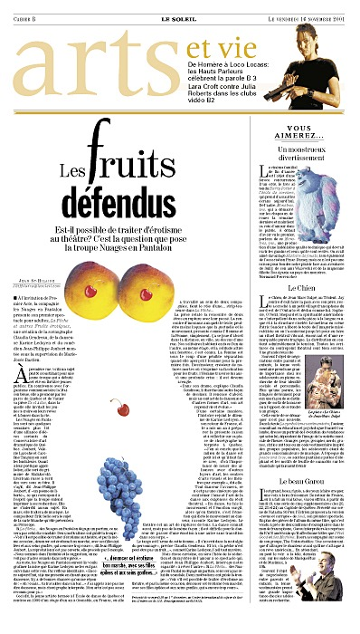
Notes:
. . . . or you can try something more risqué. Too much for your readers? (This page ran years ago in Quebec, of all places.)

Slide 27
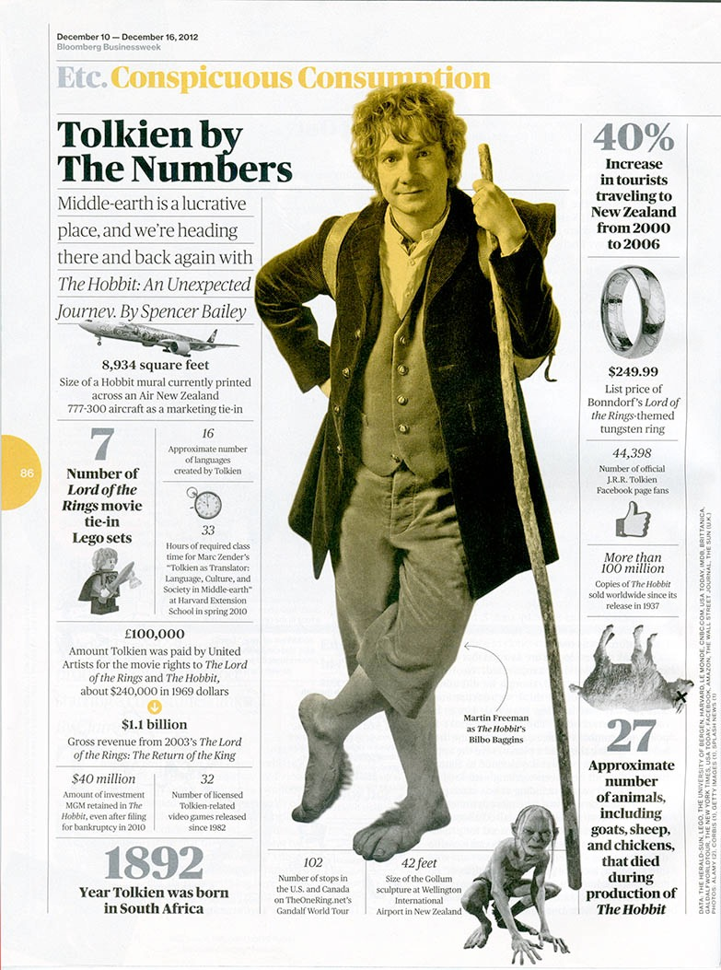
Notes:
You can attract eyeballs by the way you present information, too. Notice how much engaging data is transmitted by this hard-working (but elegantly designed) type.

Slide 28
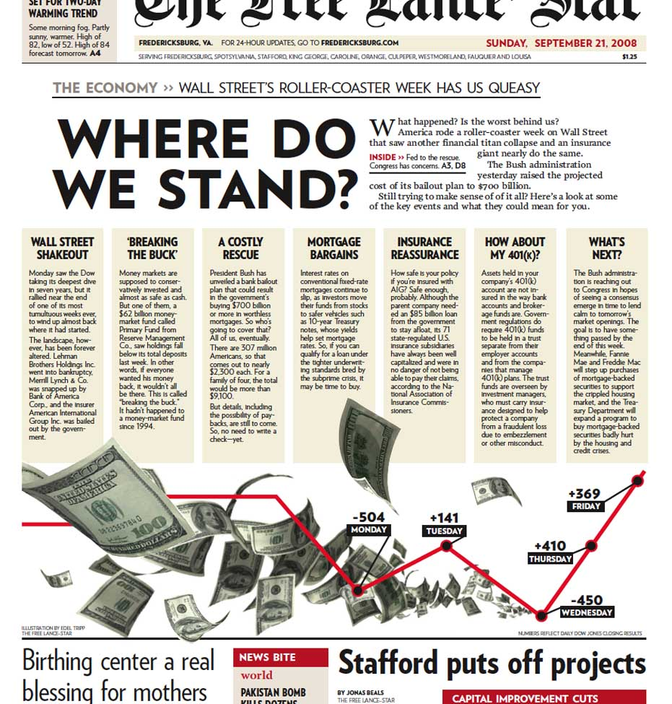
Notes:
Same here. What’s appealing about this layout is how accessible the information is. This is an extremely effective way to make dry economic data appealing by presenting it in short form.

Slide 29
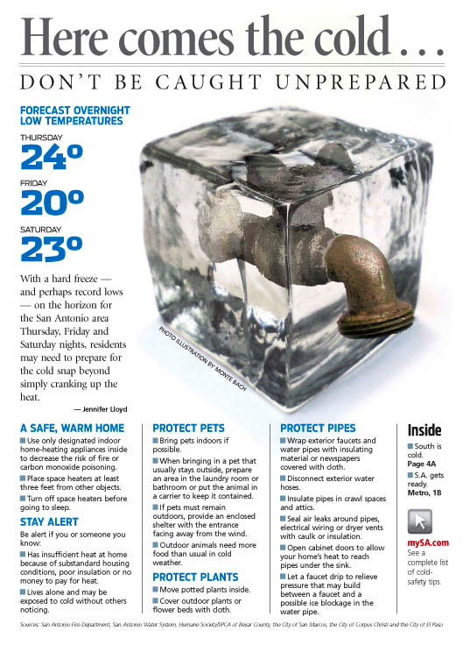
Notes:
Again, an admirable short-form alternative to your typical freeze-warning story. It’s everything you need to know in one appealing package: Cool photo-illustration. Big blue temperatures and subheads. Useful bullet items. And a web link for more info.
Or would you rather just read 15 inches of gray text?

Slide 30
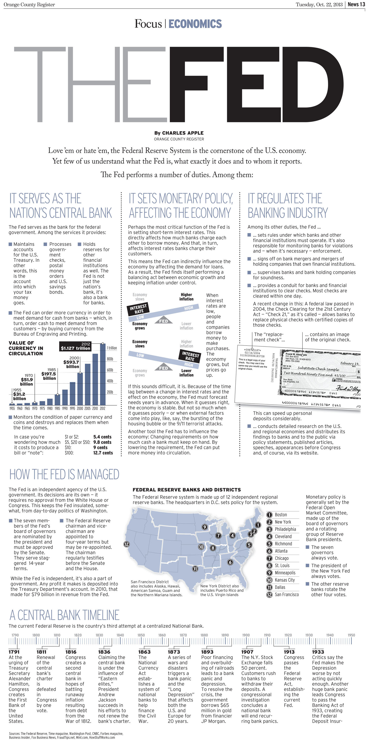
Notes:
What is the Federal Reserve System? You could try reading a 5,000-word essay — OR you could browse this impressive full-page infographic. Some would argue that it dumbs-down complex information; but others would insist that, because the page looks so accessible, it actually delivers more data more successfully than 100 paragraphs of linear text would.

Slide 32
Notes:
Enough, for now, about grabbing eyeballs (although if you want to explore more inspiring design devices, be sure to view our companion presentation, 101 Swipeable Ideas.)
Instead, let’s focus on pure journalism — reporting and writing — to figure out how to present information in the most effective possible way.

Slide 33
Notes:
Suppose you’re a reporter. A feature writer. And you’re preparing to write a story about a disturbing new trend: Dog Suicide. That’s right. It’s true!* People are going away to work or school, abandoning their miserable dogs in lonely laundry rooms all day. The poor critters are terminally depressed. Can you blame them?
*It’s not true.

Slide 34
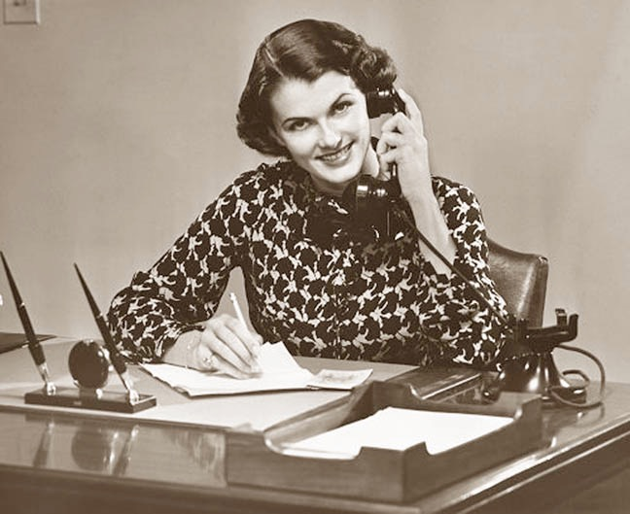
2
2
Notes:
So you get on the phone to interview veterinarians and bereaved pet owners . . . .

Slide 35
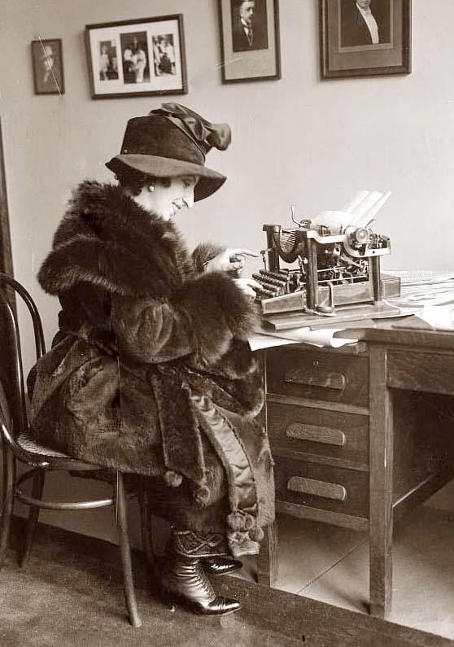
4
4
Notes:
. . . . then you sit down and type up your story. It’s going to be epic! Awesome! Heart-breaking!

Slide 36
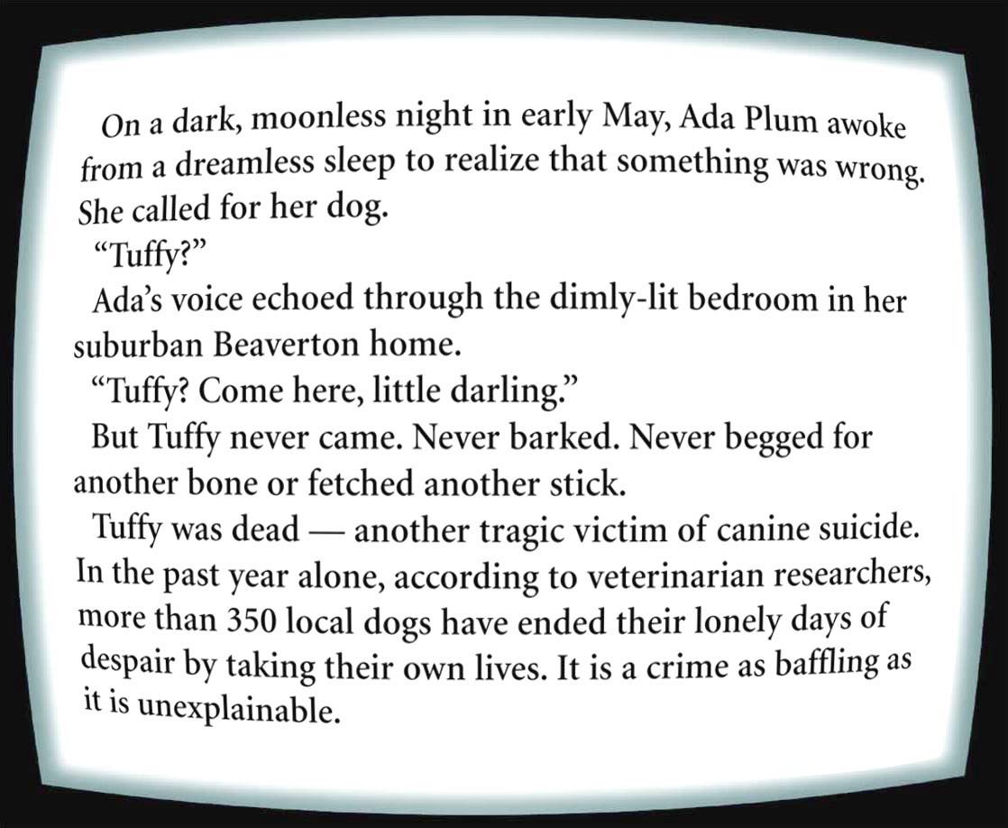
Notes:
Great stuff! You’re on fire! Readers are gonna love this!!

Slide 37
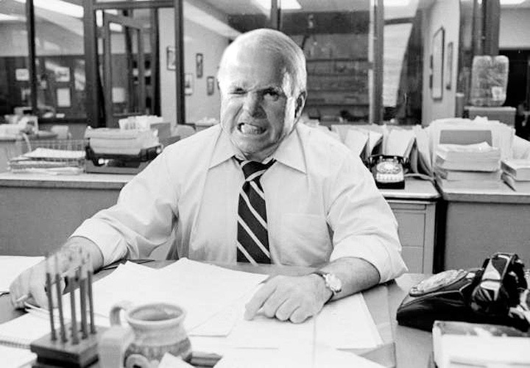
6
6
Notes:
When you turn in your story, your gruff-but-lovable editor says, “Great stuff. But where’s the photos?”

Slide 38
Notes:
So you quickly dispatch a photographer to shoot a grieving dog owner, who poses on the living-room couch for this sad (and awkward) portrait.

Slide 39
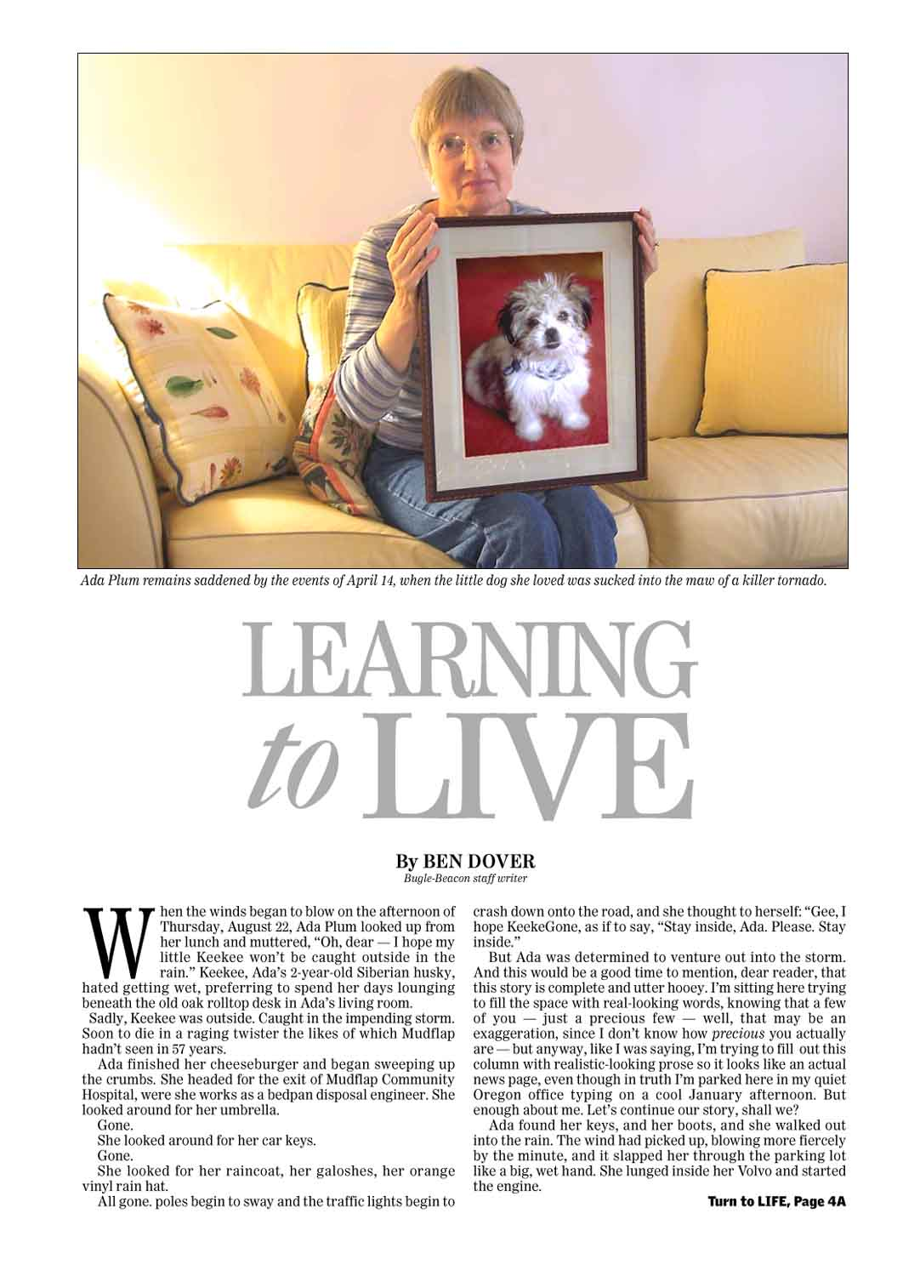
Notes:
And here it is: your front-page centerpiece. Some copy editor gives it one of those standard, alliterative feature headlines, like Learning to Live . . .

Slide 40
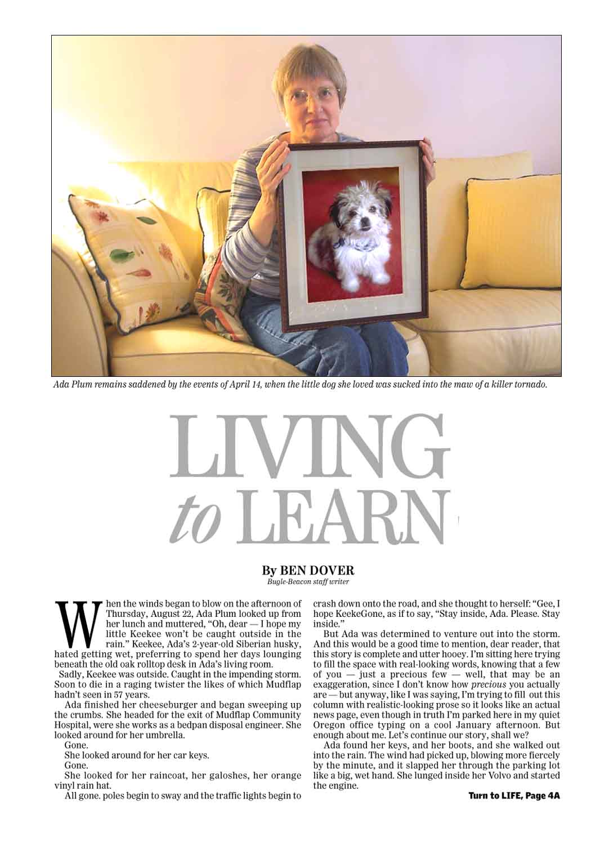
Notes:
. . . . or Living to Learn . . . .

Slide 41
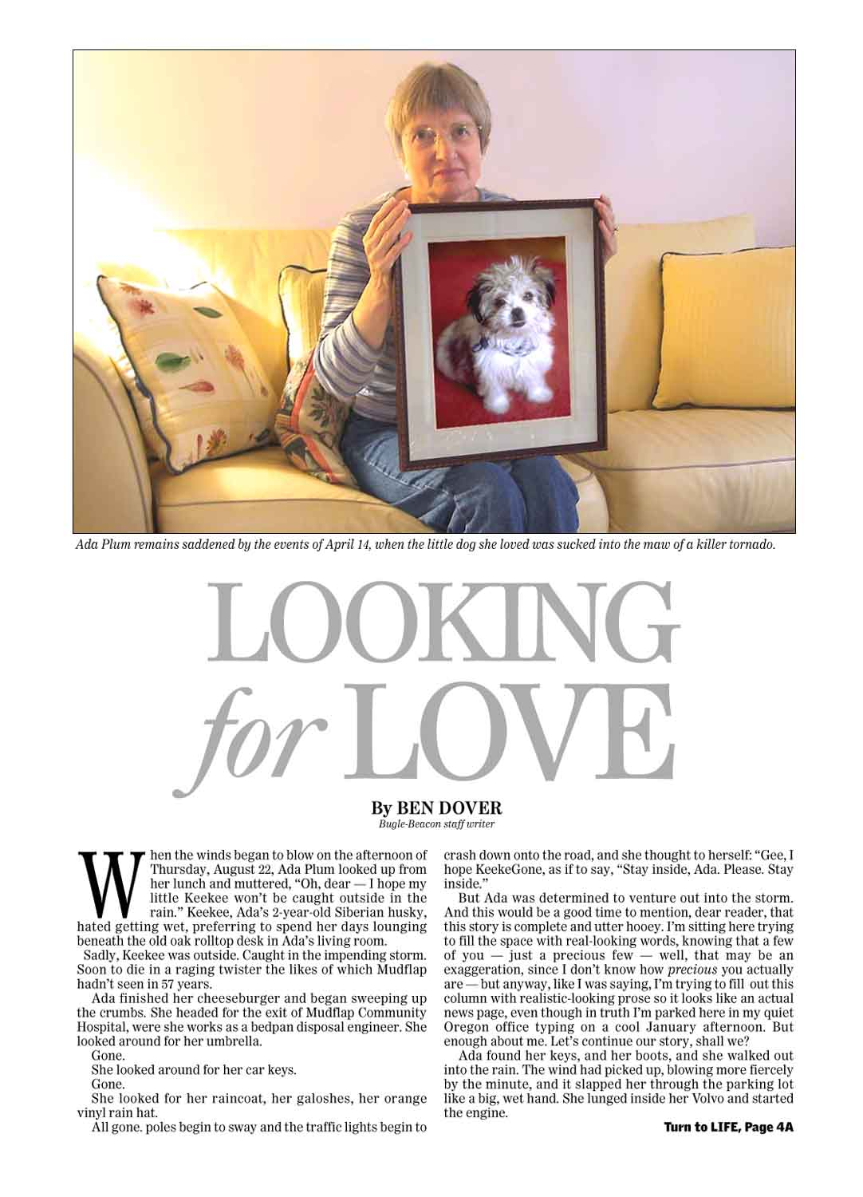
Notes:
. . . or Looking for Love. Whatever. But there it is on Page Oney. And when the story jumps to page 4 . . .

Slide 42
Notes:
. . . . it looks like this. Uh-oh. Too gray? Luckily, a quick-witted editor fixes it . . . .

Slide 43
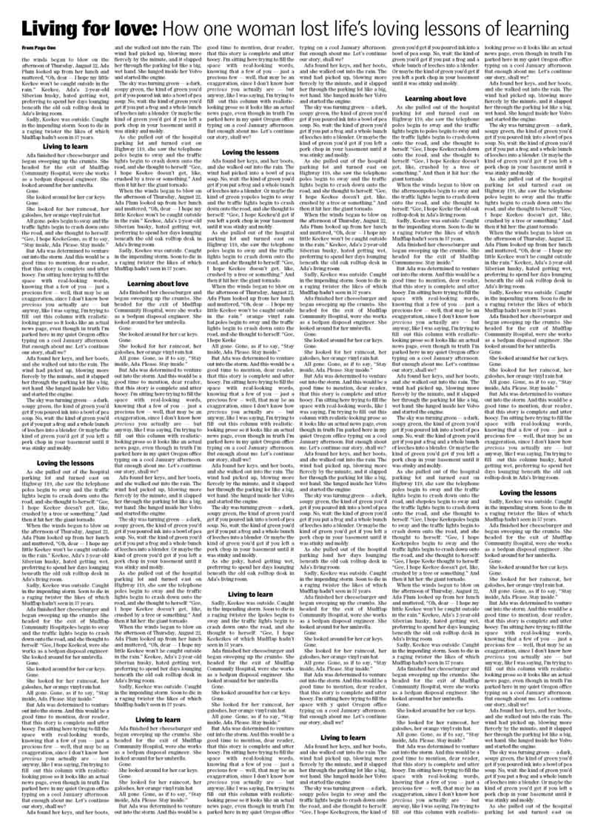
Notes:
. . . . by adding subheads. Still too dull? How about it we find another depressing photo and stick that at the top of the page?

Slide 44
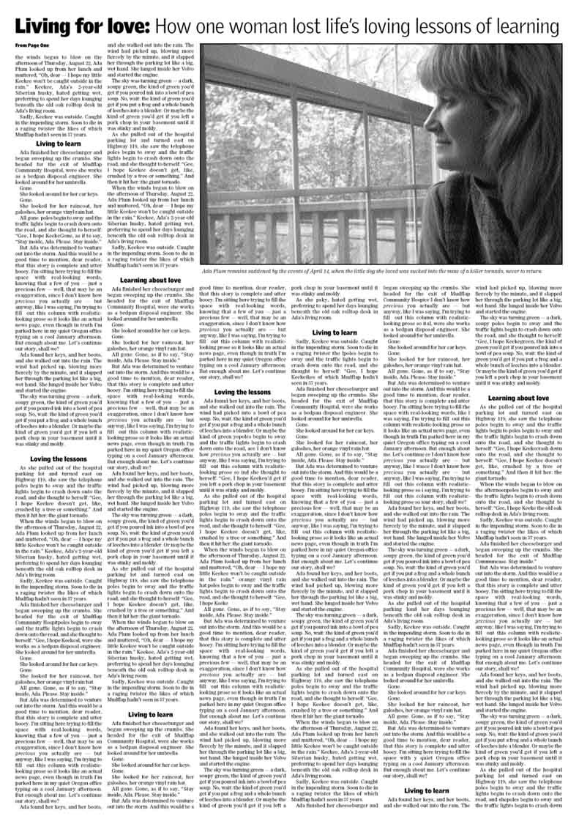
Notes:
Better, maybe. But when you see this layout, you cry, “You can’t cut 15 inches out of my story!! Make that photo smaller!”

Slide 45
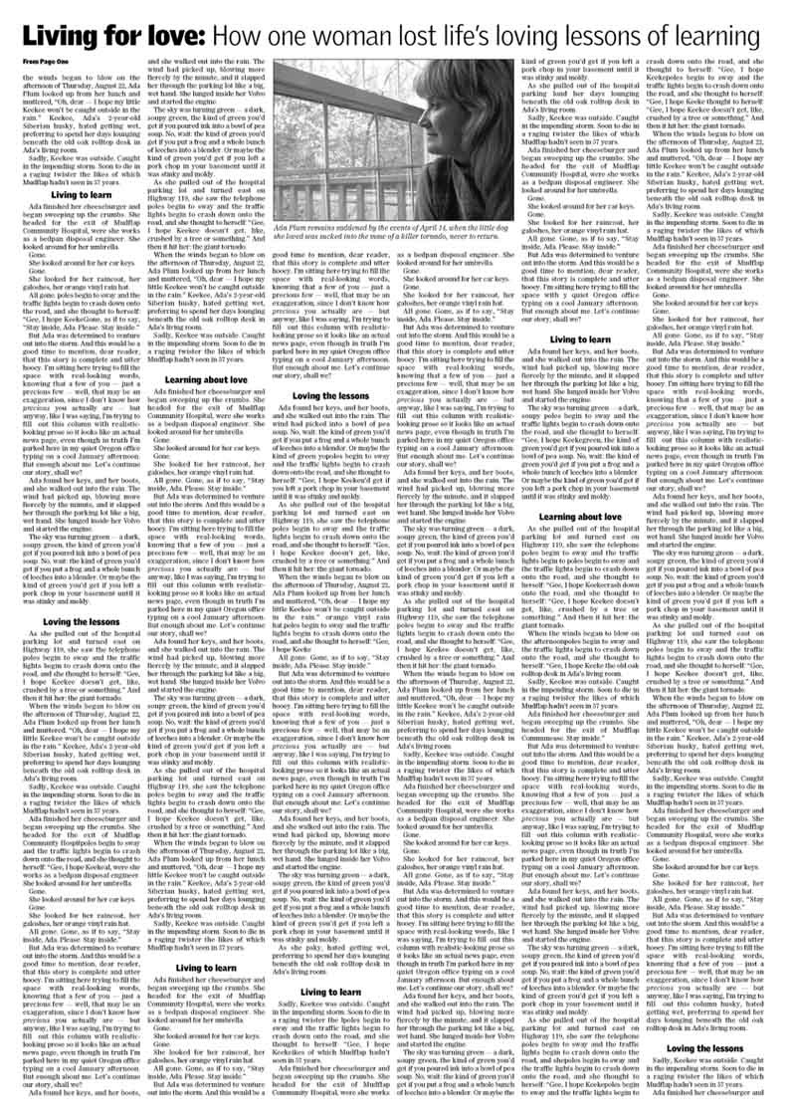
Notes:
So you compromise, and this is how the page prints.
But now that we’re done, maybe we should stop and ask: How much of this are readers gonna actually read?
Imagine that you’re a typical reader. How far would you make it? (And remember, this is a beautifully written story. Award-winning, even. Possibly.) Would you reach the end? The middle? Would you even have turned to this page at all?

Slide 46
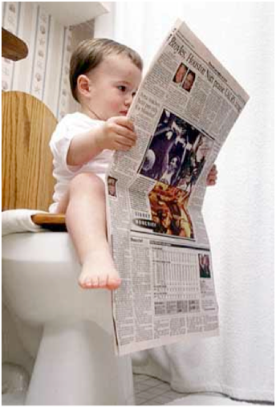
Notes:
As it turns out, newspapers are a billion-dollar industry with no accurate way to measure how consumers actually use their products.
But here’s a revealing way to see how your readers read your publication:

Slide 47
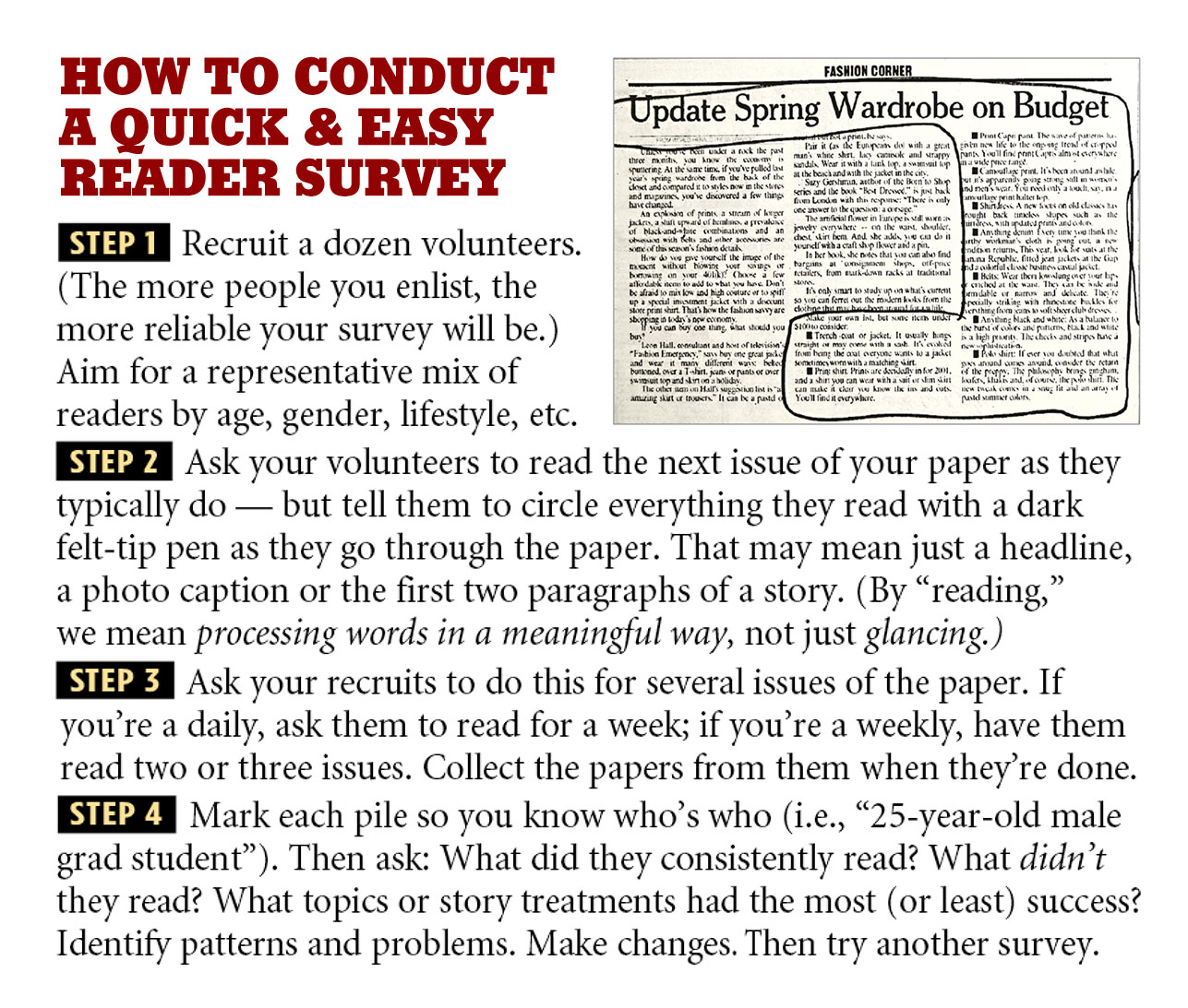
Notes:
Granted, a survey like this is more insightful than scientific. But the more readers you survey, the more accurate it becomes.
Once you begin analyzing the results, major patterns should begin to emerge.
Let’s look at some real-world examples:

Slide 48
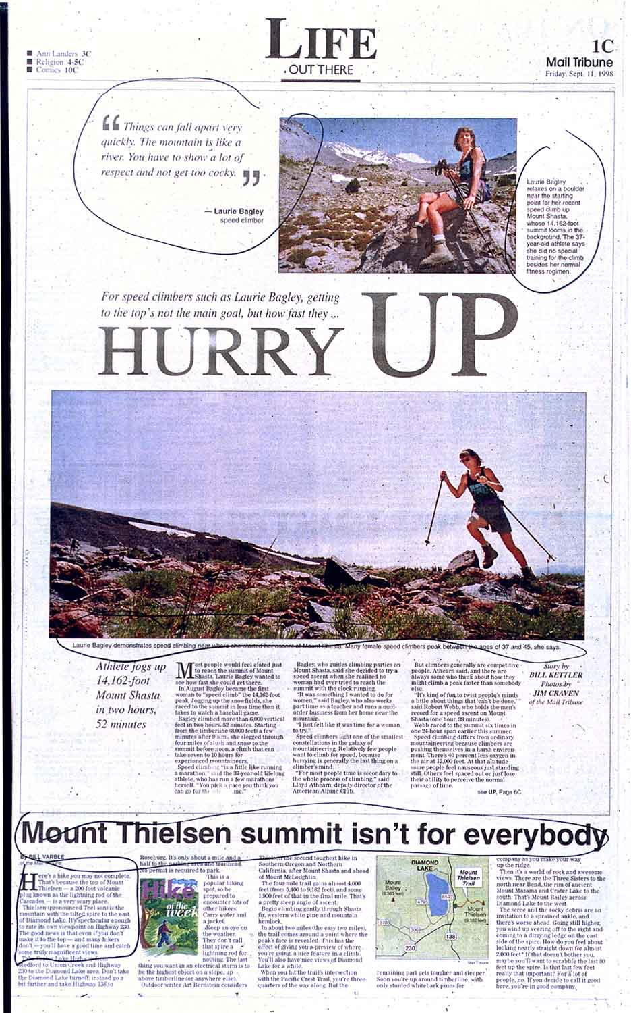
Notes:
Here’s a feature page from southern Oregon. This reader reads that big liftout quote; the cutlines for the lead story; and downpage, the headline and a couple inches of text. That’s it.
Is that unusual? Or typical?

Slide 49
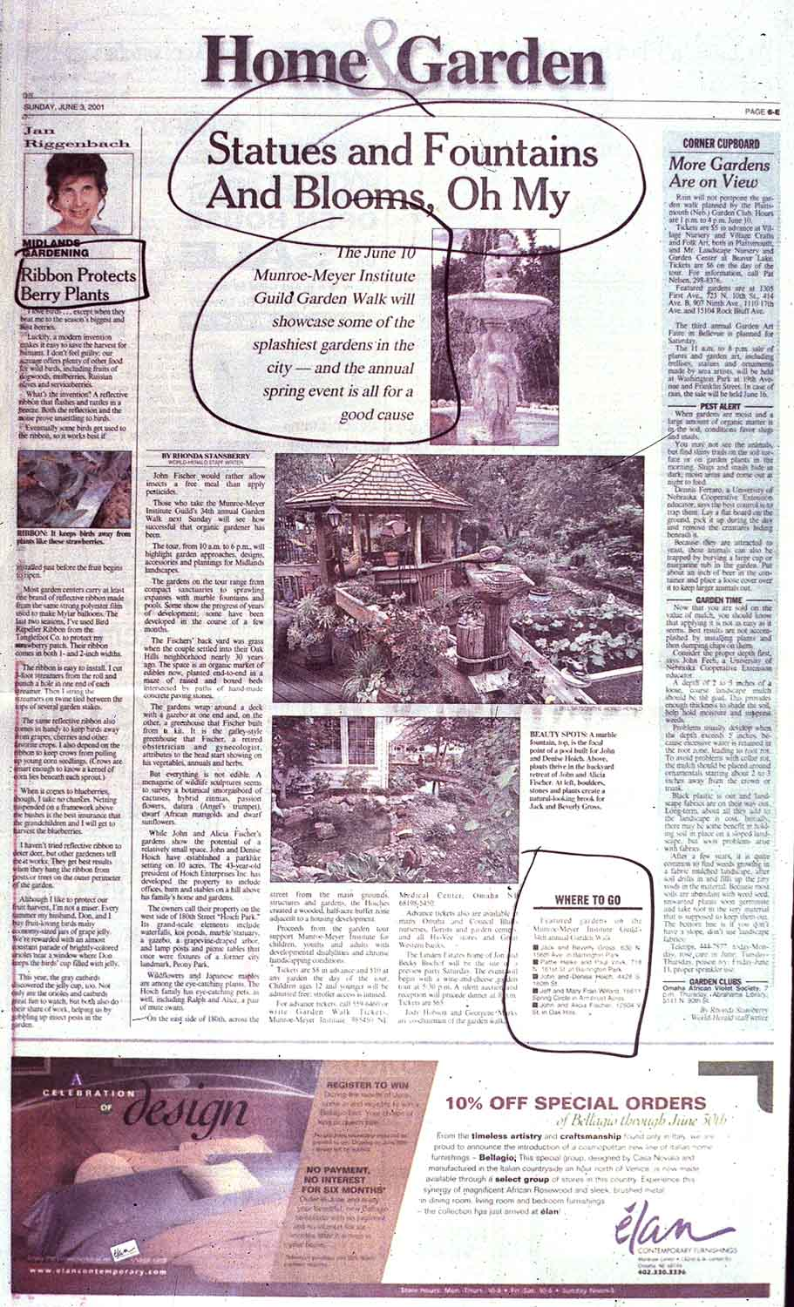
Notes:
Another feature page, this time from Omaha. This reader scans the headline type and the fast-facts box at the bottom of the page. . . . but no text at all.
Over and over again, this has proven true with feature pages like this — readers browse ‘em, but don’t actually read ‘em.
Or am I deliberately choosing examples that prove a point? (A good reason why you should survey the reading habits of your community.)

Slide 50
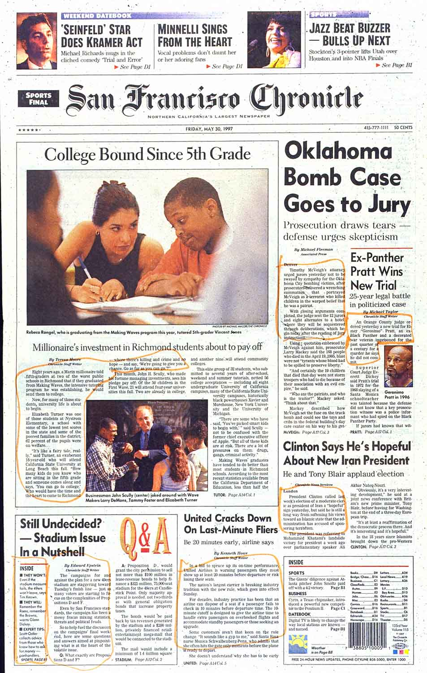
Notes:
Here we are in San Francisco. This is how an attorney reads his newspaper: one or two inches at the start of every story — four paragraphs, tops.

Slide 51
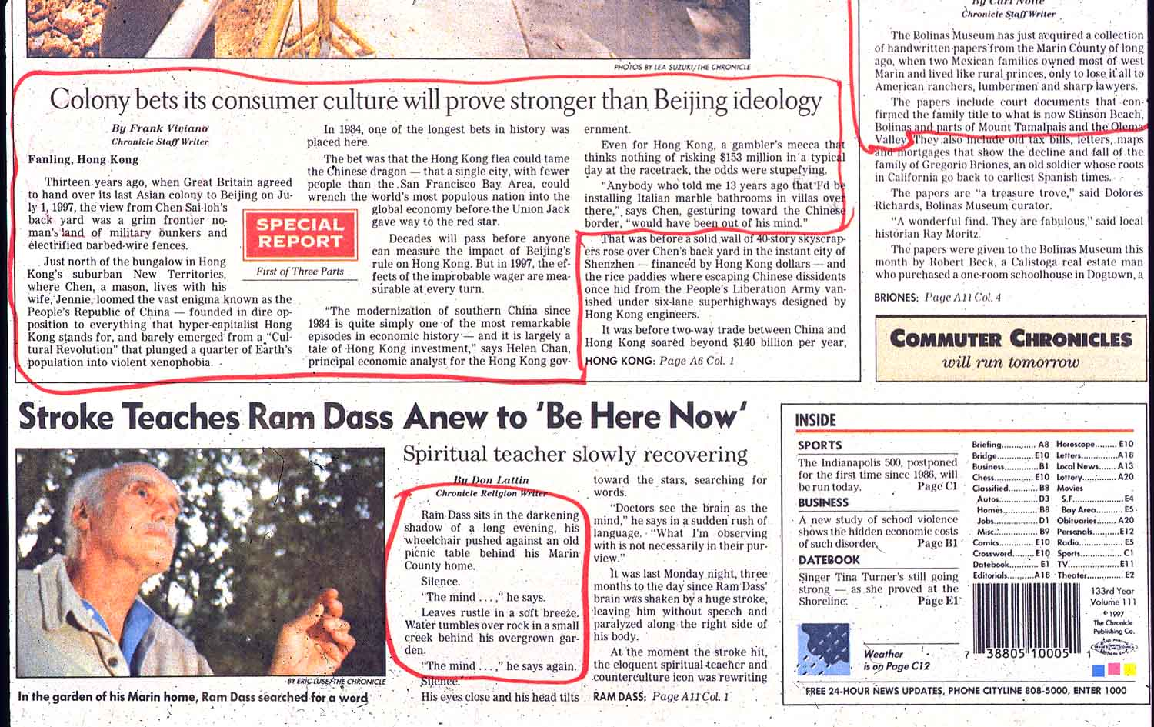
Notes:
Another page from San Francisco. Look: This reader actually read most of that top story, although, like most readers, he failed to read past the “jump,” where the story continued on an inside page. Which is true for most readers, actually. After doing this survey dozens of times, I found that readers followed stories inside only about one in 20 times (or 5% of the time).
Notice that bottom story: an engaging profile of Ram Dass, a popular spiritual teacher who suffered a stroke. Note how the reader reads just the first two inches . . . . and then the story jumps . . . .

Slide 52
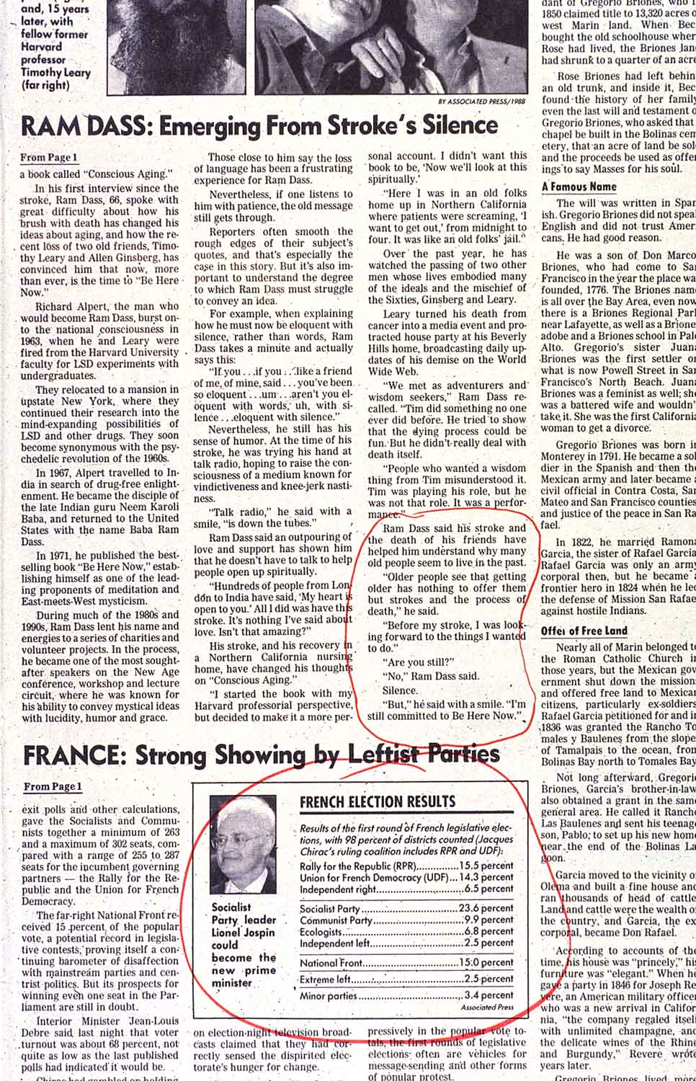
Notes:
. . . . and on the jump page, he reads . . . . . the last two inches! And then he goes on to read the fascinating French election results.
What’s going on??? Here’s what I’ve concluded: Readers aren’t lazy, or stupid. They’re busy. Distracted. Overloaded. Those long columns of text were successful in your father’s newspaper. But today (unless you’re retired or have lots of free time), they look like work. So our eyeballs are attracted to short-form data — like that France election graphic.
Think this is true for your friends and family? For you? How much of that Dog Suicide story would you have read?

Slide 53
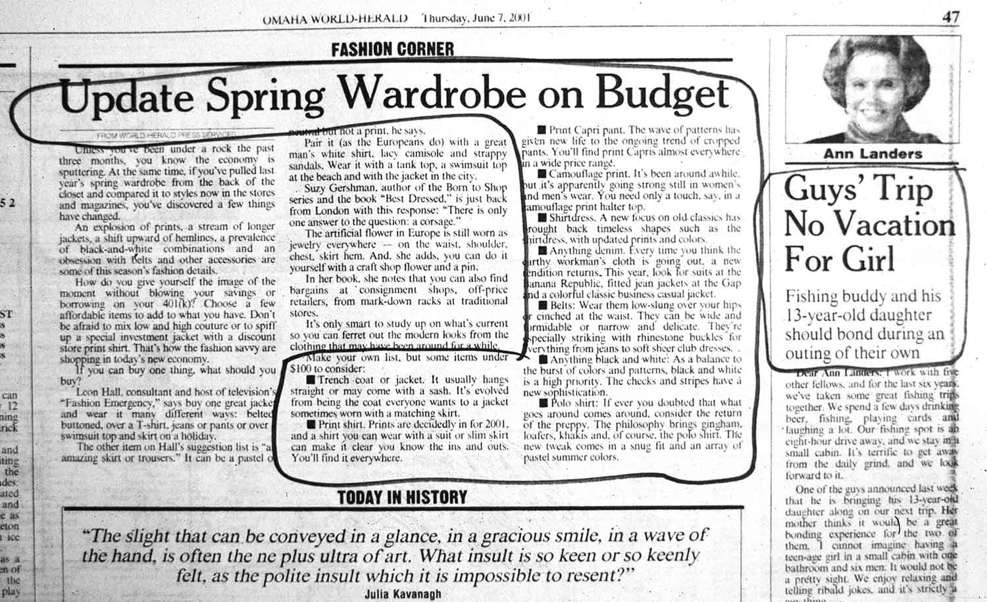
Notes:
By the way, here’s my all-time favorite survey sample. You can actually hear the reader saying: Skip the preamble. Just give me the bullet items.
What if it turns out that most readers actually feel that way? Would it change the way you approach your reporting — the way you deliver the data?

Slide 54
Notes:
Magazines have figured this out a long time ago. Take Maxim, for instance. For a while there (before it changed ownership), Maxim was wildly successful. Let’s listen to its editor explain his editorial strategy:

Slide 55
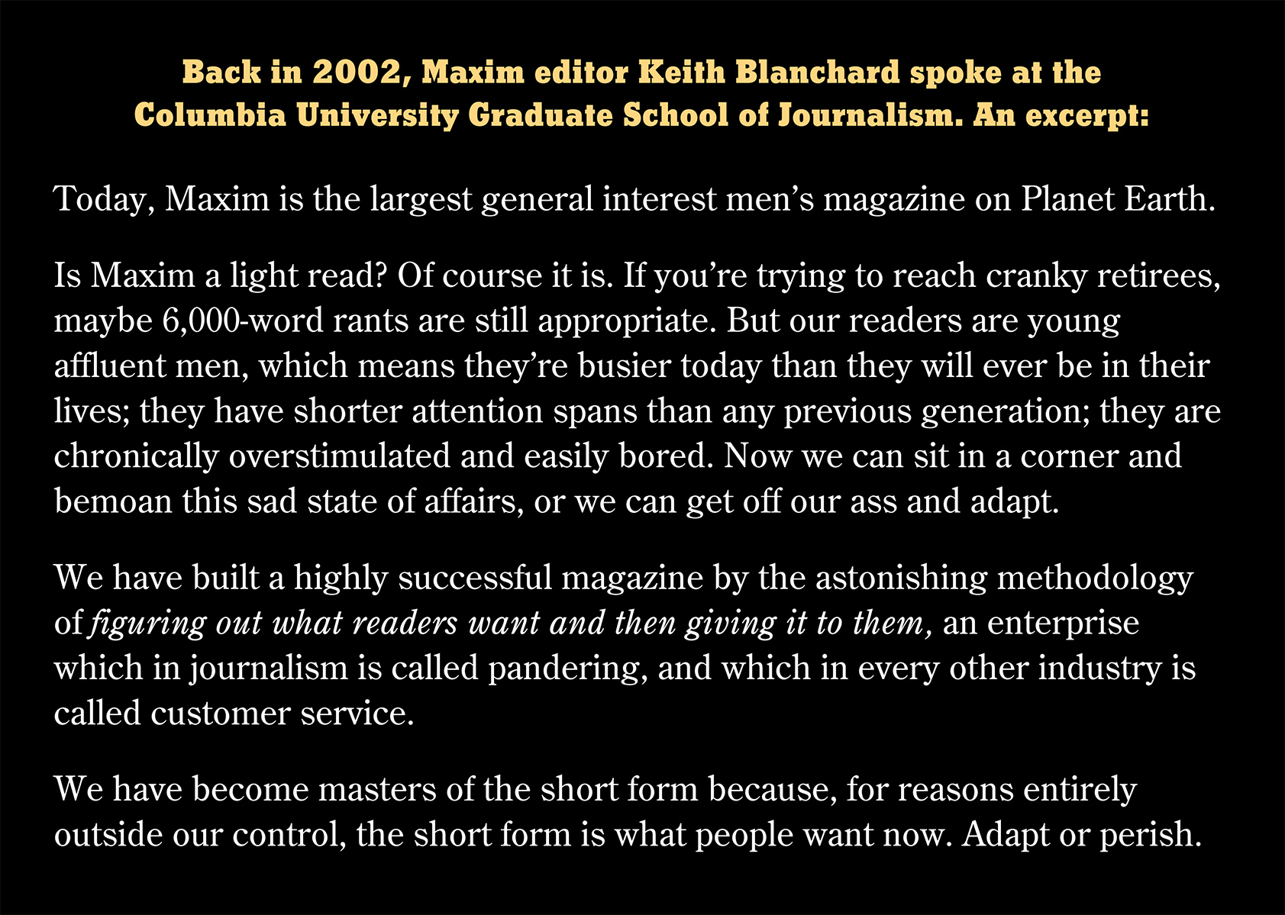

Slide 56
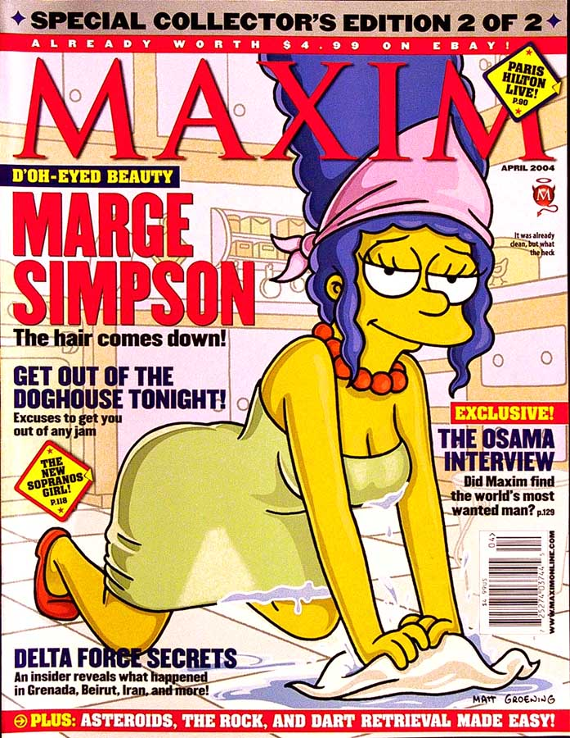
Notes:
Thumb through a typical issue of Maxim in its heyday, and notice how many long, texty stories they’re running. (Spoiler alert: none.)

Slide 57
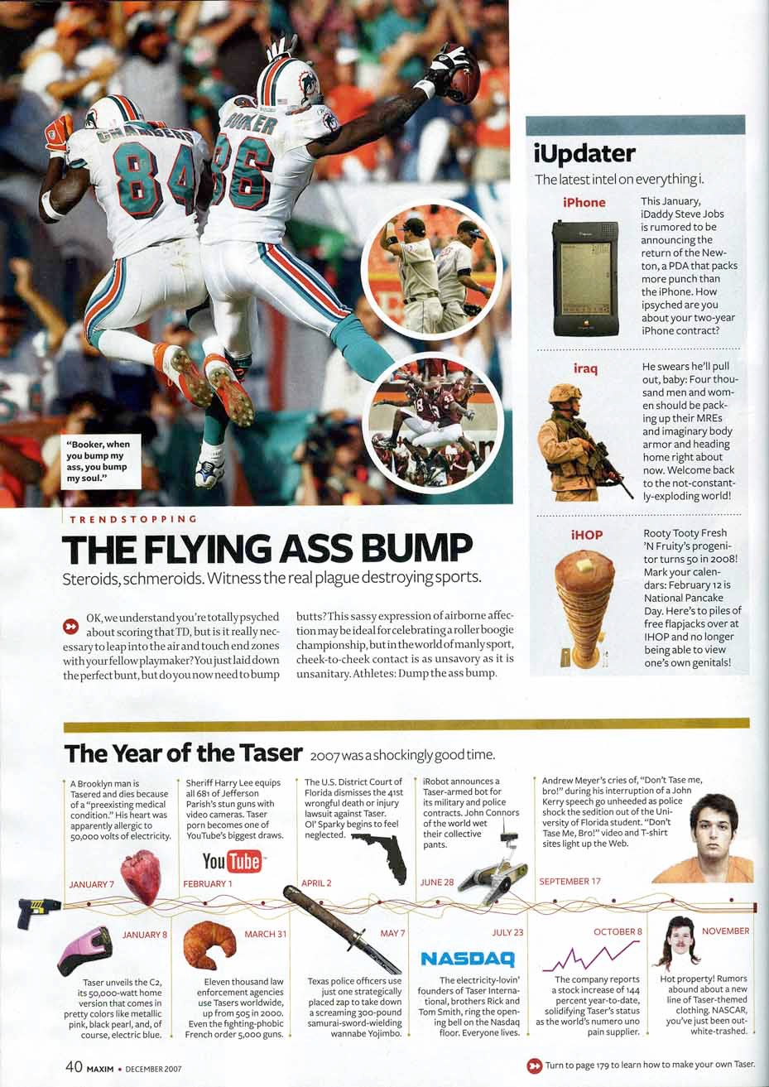
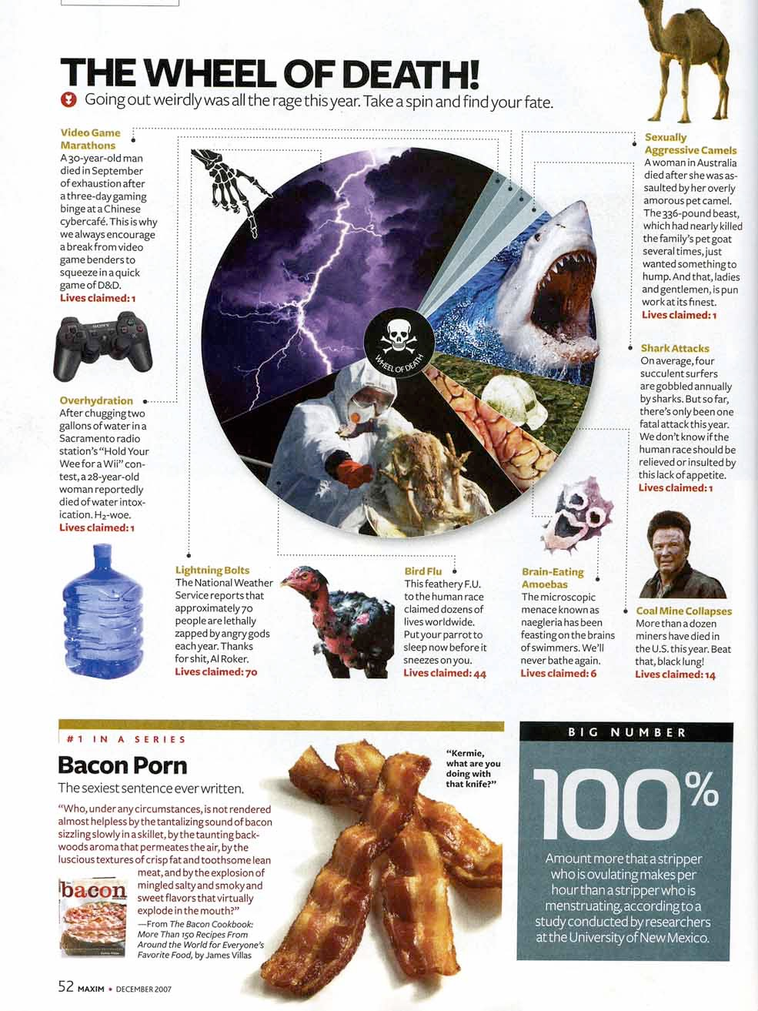

Slide 58
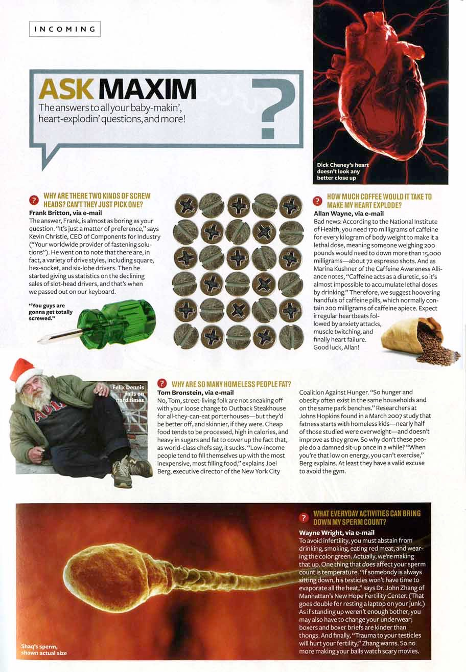

Slide 59
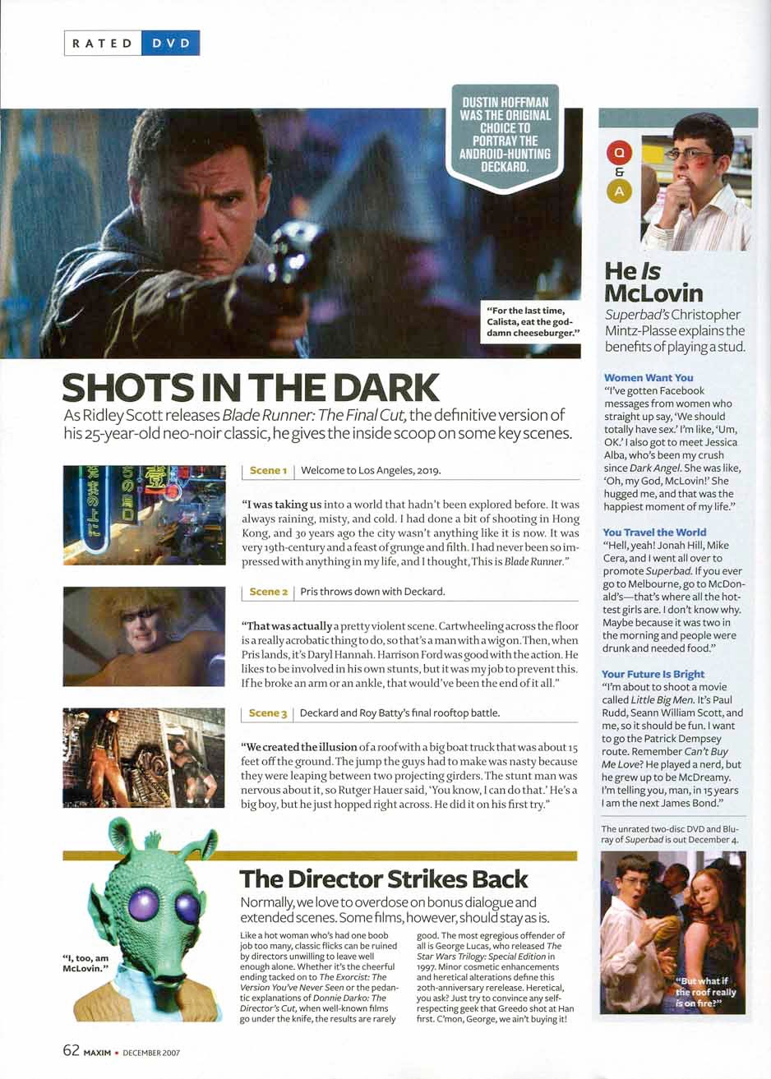

Slide 61
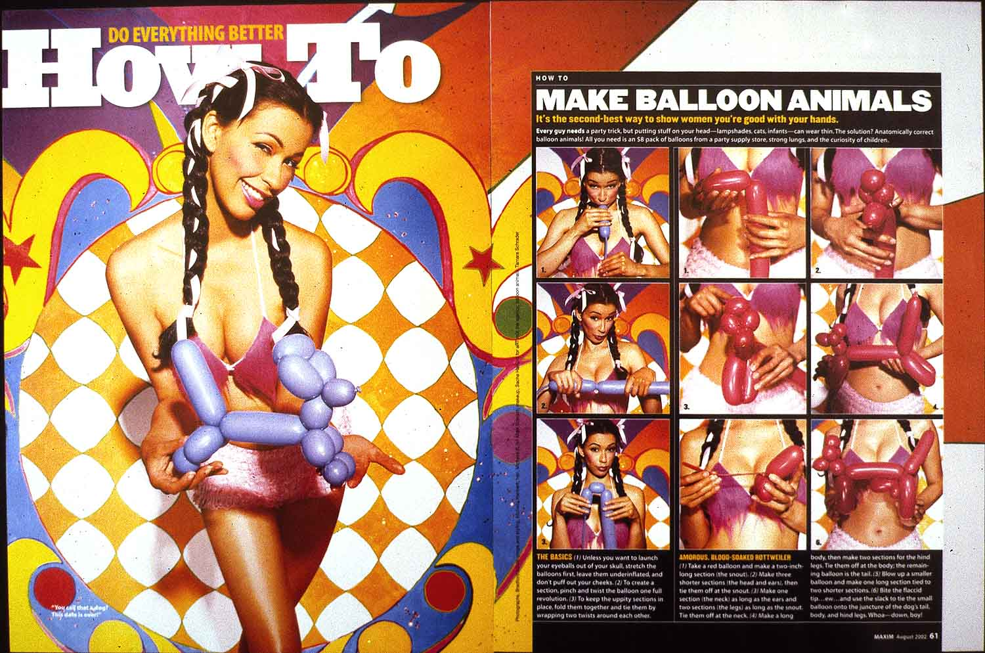

Slide 62
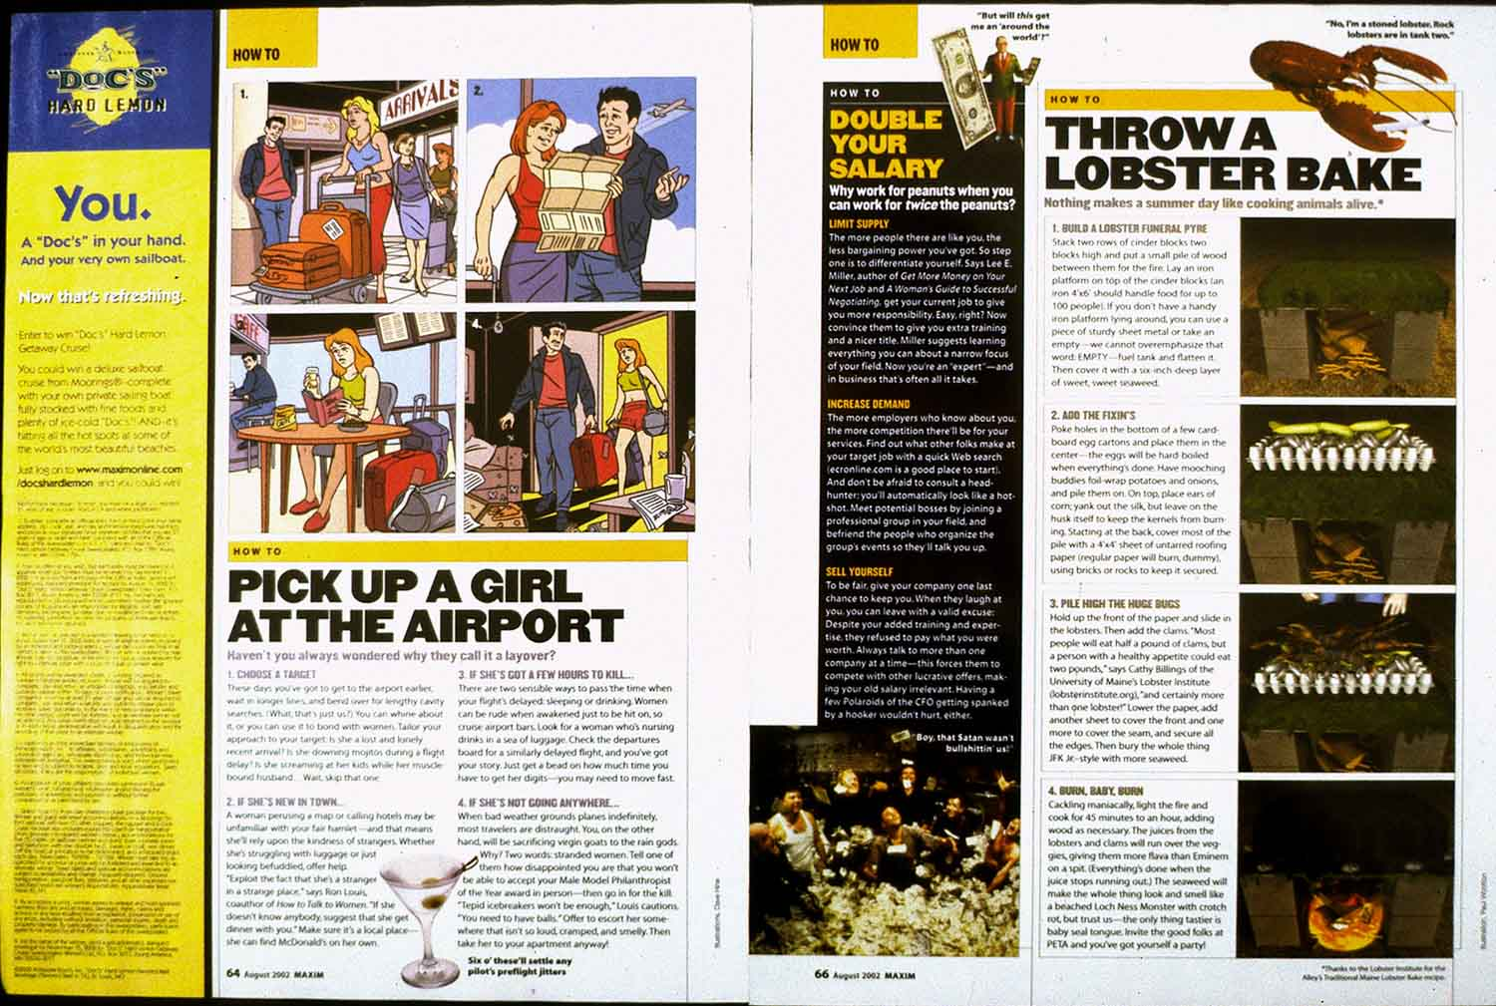

Slide 63
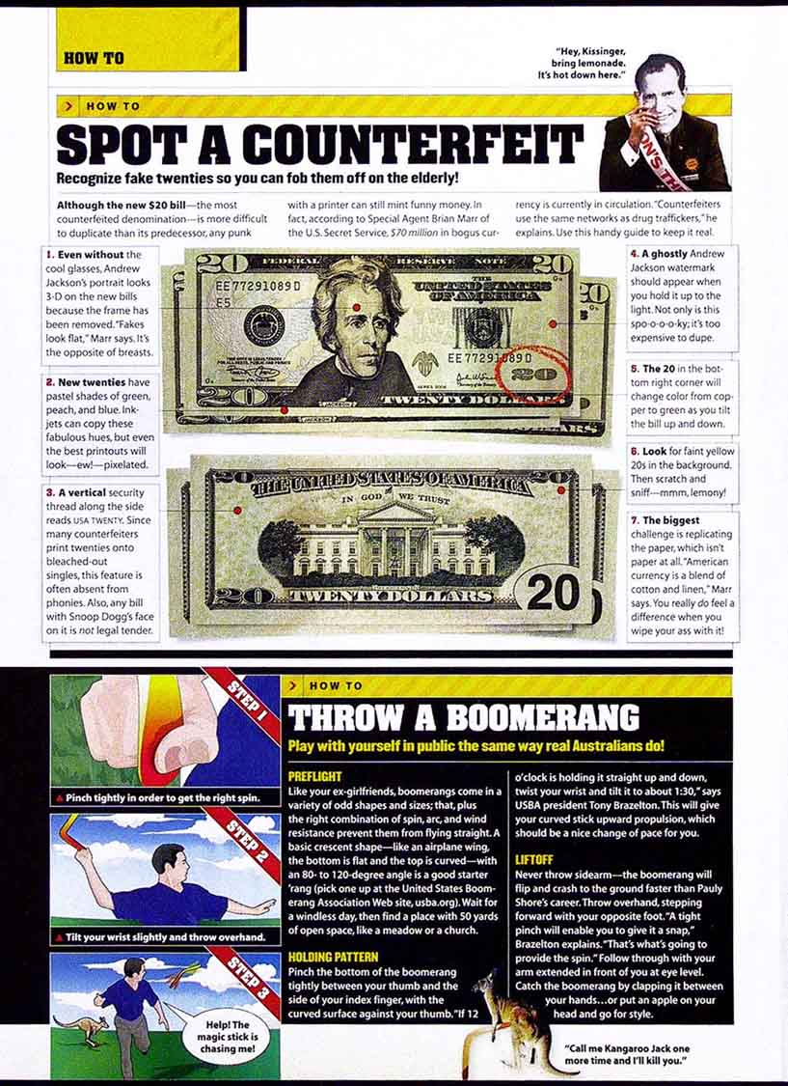

Slide 64
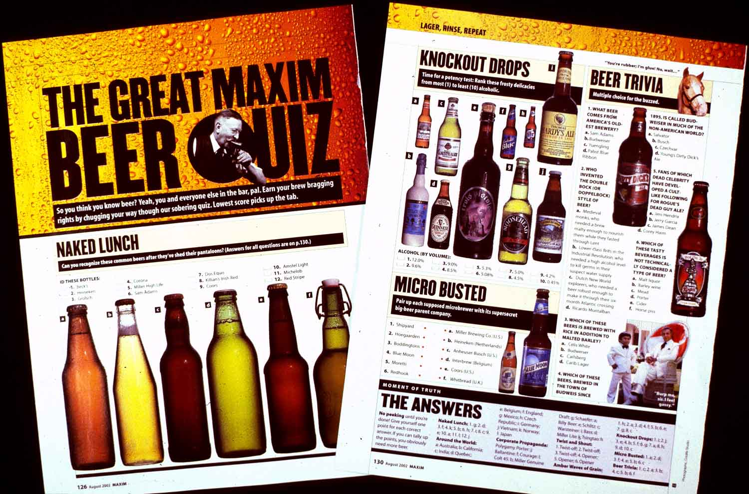

Slide 65
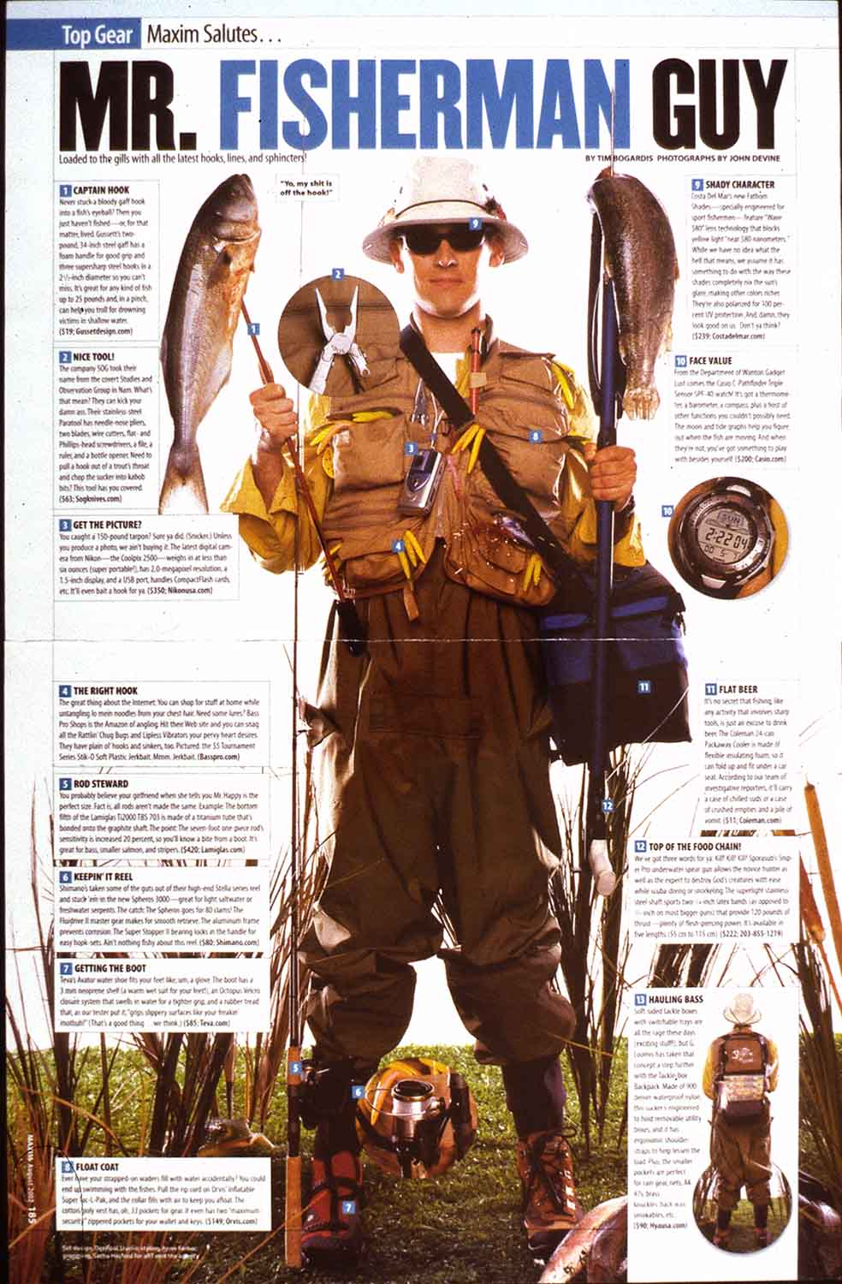

Slide 66
Notes:
Yes, it’s all short, punchy and visual. But it’s solid information — not just trivia.
Now, you could argue that Maxim is sophomoric and, yes, sexist. But consider who its target audience is. And ask yourself: Are they not giving their readers useful, accessible content?
And would an editorial strategy like this — emphasizing short-form data delivery — work effectively for other audiences, as well?

Slide 67
Notes:
Would short-form formatting work for delivering hard news? Take a look at The Week magazine.

Slide 68
Notes:
The Week’s editorial staff sifts through the best publications around the world and distills the meatiest news into data-dense paragraphs — chunks of information organized by bold subheads.

Slide 71
Notes:
Notice just how much material has been compressed into this one Business page — 11 different topics in all.

Slide 72
42
Notes:
In one survey, readers were monitored while reading both a typical newsmagazine (left) and The Week. They spent roughly twice as long, on average, reading pages in The Week.

Slide 78
Notes:
Headlines. Text. Photos. An occasional liftout quote.
If those are the only design tools in your toolbox, you may be limited into publishing what looks like Your Father’s Newspaper. All those long-form “notebook dumps” could be tough sledding for your impatient, time-starved readers.
How can you speed up their comprehension without dumbing down your journalism?

Slide 79
Notes:
To deliver more modern journalism, you need a bigger toolbox — with a variety of text and graphic options (“alternative story forms”) like these.
Let’s take a tour through some examples.

Slide 80
Notes:
The fast-fact box. Instead of burying the basic who-what-where-when down in the 17th paragraph, you can highlight it in a box that makes it easy for readers to find. You can do this for meetings. Concerts. Restaurant reviews. Sporting events.

Slide 81
Notes:
The bio box. Writing a profile of some newsmaker? A format like this adds a nice graphic touch to your story while providing an accessible way to organize basic biographical details — although you could also use it to add offbeat flavor, like the top example does.

Slide 82
Notes:
Note the power of fast-fact bullet items. Where does your eye want to go first: to the text along the right side of the page, or the WHO HE WAS/WHAT HE DID bullets along the top?

Slide 83
52
Notes:
The Q & A. A verbatim transcript of an interview. Here are two examples of Q & A’s that are short and sweet. But they can run long, too, especially for deep dives with articulate newsmakers.

Slide 84
52
Notes:
Another type of Q & A, where you ask (and answer) hypothetical questions about a current event — in this case, as the story’s lead puts it: It’s the question of the week: Who will be able to get a flu shot this year, and when?

Slide 85
52

Slide 86
Notes:
A few years back, New York governor Eliot Spitzer resigned after being shamed in a prostitution scandal. (This was the eyeball-grabbing cover of New York magazine that week) . . . .

Slide 87
Notes:
In the midst of that widely reported scandal, The Huffington Post ran this irreverent but highly entertaining Q & A that asks questions like Why do powerful men who seem to have it all, then go and screw everything up and — in case you were wondering — How does one become a prostitute?

Slide 88
Notes:
Speaking of prostitutes, here’s a page from The New York Times. Note the fast-fact box.

Slide 89
Notes:
Quizzes. Readers love quizzes. They’re interactive and personal, and work especially well on feature pages.

Slide 90
Notes:
This may be the most popular (and plagiarized) story I ever wrote, where readers get points if they’ve seen a ghost, escaped a tornado or saved somebody’s life.

Slide 91
Notes:
Diagrams. The new parking tickets are here! So what’s what? This is an engaging way to give readers a guided tour.

Slide 92
Notes:
This page is similar in structure to the previous page, and shows how to preview an art exhibit in a reader-friendly way: a few inches of introductory text, a fast-facts box, and a series of quotes from the artist as he explains how a typical painting comes together.

Slide 93
Notes:
A regular man-and-woman-on-the-street feature from the San Jose Mercury News years ago. This format could be popular in any newspaper: Why We Wear What We Wear.

Slide 94
Notes:
Step-by-step instructions. In this case, how to throw a toga party . . . .

Slide 95
Notes:
. . . . how to roll a joint . . . .

Slide 96
Notes:
. . . how to make a wizard wand . . . .

Slide 97
Notes:
. . . . how to kill a zombie . . . .

Slide 98
Notes:
. . . . or how to strip for your girlfriend (a special package for Valentine’s Day).

Slide 99
Notes:
Top Ten lists. Movies, wildfires, burgers — you get the idea.

Slide 102
Notes:
Polls and surveys. From political issues to pop culture — give readers choices, collect their responses (mail-in? online?), then tabulate the results.

Slide 103
Notes:
You can package poll results in a variety of ways, whether in list form (with artwork) or as infographics (with pie charts, for instance).

Slide 104
Notes:
You can find more inspiring examples of all the above sidebars either by Googling, say timelines, or by consulting “The Newspaper Designer’s Handbook.”

Slide 108
Notes:
For years, students have been told that THIS is the ideal model for conveying information: the essay. Paragraph after paragraph . . .

Slide 109
Notes:
. . . . after paragraph . . . .

Slide 110
Notes:
. . . . after paragraph. So if your target audience is, say, a college professor, this is how you deliver the data.

Slide 111
Notes:
For years, then, this guy has been the gatekeeper for those long-form essays. He’s the guy you always needed to please. But what pleases him may not actually please most normal people.
(Incidentally, I debated whether it was sexist to depict this stereotypical professor as a man. After all, just because someone’s in a position of authority, we shouldn’t automatically assume it’s a dude. But then I thought, “Would it not be sexist to use a grumpy woman to represent all college professors?” This is always a worthwhile dilemma to ponder, especially if you’re a journalist or page designer, though you can argue back and forth without ever really reaching an infallible verdict.)

Slide 112
Notes:
Sadly, most normal people don’t have the interest or the patience for theme papers like this. In the real world, they grade them much more harshly.

Slide 113
Notes:
So wouldn’t that be true for news stories, as well?
Take a story like this: A few years ago, consumers across the country began contracting salmonella food poisoning from tainted tomatoes. Everyone was nervous, and justifiably so.
So here’s how most newspapers presented their front-page story: a generic tomato photo, and 20 (or more) inches of traditional text.

Slide 114
Notes:
Or is this a more efficient way to present that information? Here, the important info is broken into short, digestible chunks. It’s more concise (and much less detailed) — but might it communicate more easily and effectively?

Slide 115
Notes:
Another example — same story, different front page. But again, ask yourself: Does this “chunked” version of the story communicate in a more accessible way?

Slide 116
Notes:
Suppose the president gives a speech . . . . in this case, announcing a major new jobs proposal. Here’s the traditional way to lay out that story: big photo, headline, and a dozen meaty paragraphs of text.

Slide 117
Notes:
Would readers prefer this version, instead? We’ve added a liftout quote to that photo. But more importantly, we’re using boldface bullets to highlight key points of the plan.

Slide 118
Notes:
Or is this even more effective: packaging key points of the plan in a colorful sidebar?

Slide 119
Notes:
But wait! How about this: A more dramatic display headline. A few inches of introductory text. Bullet items that detail points of the plan. Reactions from key members of Congress. And a “What Happens Next” sidebar leading to more stories inside the paper.

Slide 120
Notes:
Your Father’s Newspaper vs. a chunked, short-form alternative. Which do you prefer?
More importantly, which would do a more effective job of attracting eyeballs and keeping them engaged for a longer period of time?

Slide 121
Notes:
Let’s look at some different ways newspapers have chunked stories. (And remember, the intention here is NOT to trivialize information, or to dumb it down. The goal is to make important information more accessible.)
A big blizzard is coming. How big? How bad? How soon?

Slide 122
Notes:
Look at the delivery of information in this package. How much did the writer depend upon traditional inverted-pyramid reporting?

Slide 123
Notes:
Budget stories are often extremely tough to comprehend. Which version do you think communicates better — the main story, using narrative text, or the sidebar, which itemizes the key statistics?

Slide 124
Notes:
Here’s a restaurant review aimed at readers with small budgets and short attention spans. Note how everything on the page is bite-sized and easy to digest.

Slide 125
Notes:
This two-page spread in an entertainment tabloid provides everything you need to know to survive the coming zombie apocalypse.

Slide 126
Notes:
Notice how two of the three stories on this front page use boldface keywords to introduce chunked paragraphs summarizing key bits of information.

Slide 129
72
Notes:
Journalists — especially newspaper journalists — are notoriously bad at collaboration. Don’t believe me? Take a look at this typical feature page.
It’s easy to predict how that lead story came together: 1) The reporter decided to find out — as the first sentence clearly states — “What’s the best way to tone your abs?” So he talked to some experts, got some useful tips, and typed up a long story.
2) Then the reporter (or maybe an editor) ordered some photos, and a photographer ran off to the gym. Or, better yet: they found a trove of free photos (!!) from the American Council on Exercise.
3) Next, a designer laid out the page so the photos and text looked attractive and tidy. Unfortunately, the photos don’t really make much sense on their own, and it’s hard to find where they’re explained in the text. . . . but the readers can sort that out for themselves, I guess.
4) The designer left space for a big headline, and a copy editor came up with: AB-SOLUTE BEST. It’s a pun! Copy editors are word people who love clever puns, even if their meaning is vague . . . . . like this is.
So this is how a typical newspaper page comes together. The end result isn’t terribly compelling, though. And notice how the story, the photos and the headline fail to work together in any obvious way. They’re disconnected from each other. Like the staffers who produced this page.

Slide 130
73
Notes:
NOW here’s that same story presented in Men’s Health magazine. Notice the difference? See how the big headline and photo work together? How the headline leads right into the text? How the text gets right to the point? How the cutlines describe each photo sequence?
Does this page grab your eyeballs? Deliver the data in an effective way?
Or do you prefer the newspaper version?

Slide 131
Notes:
Yes, collaboration is hard, but the results can be terrific — even in a small newsroom like the one at the N-West Iowa Review, an award-winning weekly paper.
Let’s thumb through a typical issue of their entertainment tabloid.

Slide 132
Notes:
Here’s that cover story, on martial arts classes for kids. It occupies a two-page spread. Notice the format: a few introductory paragraphs, then a half-dozen short-form options ranging from lists to fast-fact boxes to a Q&A and a glossary.
There’s a lot of information here, but very little traditional text.

Slide 133
Notes:
Another story (by that same writer) about upcoming clown classes. Again, a short introduction followed by a sidebar, a Q&A and some fast facts.

Slide 134
Notes:
Another short-form layout — again, in the same issue — because hey, it’s almost racing season! Here’s all you need to know on one page: where the races are, what types of cars, and how to attend the upcoming racecar show.

Slide 135
Notes:
Yet another short-form preview. In fact, nearly everything in this issue is packaged in short, appealing chunks like this.
Did these stories come together like that by accident? No. The newsroom has a system in place for planning and packaging stories with this end result in mind.
And that system is known as “The Maestro Concept.”

Slide 136
Notes:
The Maestro Concept was devised back in the 1990s by Leland “Buck” Ryan, a journalism professor (and longtime friend of the author). For a detailed analysis, I recommend the Wikipedia entry for Maestro Concept.
In short, it’s a process for encouraging teamwork among newspaper staffers. For integrating words, images and design. For reminding journalists to “think like a reader.”

Slide 137
Notes:
Basically, the concept is this: The best time to collaborate — to brainstorm that big story — is before the story gets written. Before the reporter sits down, alone, to start typing those 30 paragraphs of text.
So imagine a meeting where we kick that story around: we being the reporter. The editor. The photographer. The designer. In fact, anyone who’s got a stake in that story gets to help shape its treament during a quick (five-minute session) where they fill out this form. Together. Collaboratively.

Slide 138
Notes:
Here’s an overview of how that works. At left, the completed maestro form, which resulted in the printed page at right.
Now, things may surely change as the reporter gathers more information, or as the artwork comes together. But with this process, at least there’s a beginning blueprint that guides the evolution of the package.
If you’re presenting this slideshow to a class or a newsroom and you’d like to test-drive the Maestro Concept, the next 10 slides will guide you through a typical front-page example.
If you would like to print out a physical copy of this form, 1) export the previous slide, scale it to fit your printer output, and print out copies, or 2) download a PDF of the maestro form from the NSPA website, then print out copies as needed.

Slide 139
Notes:
OK, here we go. We’ve got a big, breaking story for tomorrow’s front page. So first thing, top left corner of the maestro form: What’s the story idea, in 25 words or less? (This forces the reporter or editor to boil the concept down into an easily digestible nugget.)
In this case, here it is: UFOs have been landing at night, abducting local citizens.
Make sense? Once everyone understands the concept and agrees that it’s worthy, you proceed to the next section.

Slide 140
Notes:
Now, think like a reader. What are the biggest, juicest, most pressing questions readers will have about this topic? For instance, how about: Where have the abductions occurred? (Is it anywhere near MY house?) Excellent question. And how should we answer that question? Can we do it with a photo? With a headline? Down in the 17th paragraph of the text? Or is there a sidebar that would work . . . . like, say . . . a map?
You don’t have to write anything down just yet. But keep churning out questions, like: Who’s been abducted? Is this some kind of hoax? Are the abductees claiming that they were probed? And for each question, try to determine the best way to answer: text, artwork, sidebar, graphic . . . .?
But the most important question of all — the one you must ask for every story you ever do — is this: Why should I care? The answer may not always be obvious, so try asking in different ways: How does this affect ME? Or . . . . . What should I be doing about this?
Once you feel confident about your questions and answers, fill in the form and move on to the next section.

Slide 141
Notes:
At this point, you could begin discussing photo options (with the photographer right there, helping guide the process). Want mug shots of the abductees? Can you get a photo of the UFO tonight? Or should the lead art be the map that shows where the UFOs have landed?
Your page designer could now start sketching out the package: put the artwork here, the sidebars there. In fact, you could even kick around headline ideas now — while you’re fresh — instead of saving that for last, when everyone’s tired and pressured by deadlines.
That’s the process in a nutshell. When it works, it makes those big stories more accessible, more reader-friendly, better-designed, more visual. It encourages collaboration by spreading the ownership around — it’s not just the reporter’s story anymore.
So let’s see how this page might have actually turned out:

Slide 142
Notes:
If we hadn’t maestroed the story, a photographer would have visited one of the abductees and shot this corny photo of the guy saying, “Here’s where they probed me.”

Slide 143
Notes:
That photo would have anchored this traditional story design: Headline, deck, photo, and 20 paragraphs of traditional text. And there it is: your front-page centerpiece. Perfect for your father’s 1966 newspaper.
But what if we had constructed a package based upon the questions on our maestro form?

Slide 144
Notes:
First, let’s fix the right half of the layout. Instead of that corny photo, we’d run a map to answer the question, Where have the abductions occurred?
And maybe our second question was: Who’s been abducted? To answer that, we created bio boxes for each of the abductees — and paired those with our map to show who was abducted where.

Slide 145
Notes:
What was the “Why should I care?” for this story? Hopefully, you would have come up with something like: How do I protect myself from the aliens? And to answer that question, you could ask a UFO expert for a list of bullet-item tips — and you’d run it here, at the very top of the story.
Notice, too, that we’ve jazzed up the headline a bit more, since we’d written it in advance.

Slide 146
Notes:
Like the layout so far? If I were in charge, I might have asked one more question during the maestro meeting: Is this just a hoax? Which we could have answered with a quick reader survey (maybe send someone to the mall and ask 100 people these questions.)
Could be a good sidebar. Or maybe it’s just making the page too busy. Now that I see it in print, I think I’d prefer . . . .

Slide 147
Notes:
. . . . this version. OR do you prefer . . . .

Slide 148
Notes:
. . . . the traditional version — the one that would run in Your Father’s Newspaper? Which version attracts eyeballs better? Delivers the information more effectively?

Slide 149
Notes:
If you’re intrigued by this process, you’re bound to have questions. Such as:
— Do we do this for every story? Probably not. At first, it may be best to focus on your big lead (centerpiece) news, feature or sports stories. Change, after all, is difficult. But once the workflow smoothes out, you could require this for, say, all stories over 20 inches. Or 20 paragraphs. Or 1,000 words.
And test your readers to see if they’re actually reading more material this way (see slide #46 above).
— Who’s in charge? Many papers have had success with creating a Staff Maestro position — someone who “gets it” when it comes to merging words and visuals in short-form packages. But it doesn’t need to be that formal. What’s important is to encourage, or even mandate, maestroing each big story, since most journalists loathe meetings — and reporters, especially, hate being forced to share ownership of their stories.

Slide 150
Notes:
Let’s review. In particular, let’s review this “Why Should I Care?” concept.
Take this front-page story, for instance, on . . . . sewer rates. (And by the way: You know you’ve hit rock bottom when a story on sewer rates leads your front page.)
Anyway, read the headline. Read the deck. And now tell me: Why should I care?

Slide 151
Notes:
Ah! Here’s the answer, buried halfway down the page: Your sewer bill will increase five bucks a month.
At the very least, shouldn’t THAT have been somewhere in the big type?

Slide 152
Notes:
Two pages from 2010, when Congress approved dramatic health-care reform (known as Obamacare).
Which do you prefer: the traditional approach at right, or the more typographically aggressive, what-it-means-to-you approach at left?

Slide 153
Notes:
Another what-it-would-mean package (from the Virginian-Pilot), on a plan to expand the local naval base.

Slide 154
Notes:
Or this example — a money story — from Time magazine.

Slide 155
Notes:
Here’s a budget story from the Columbus Dispatch. These stories can be awfully dull, but by 1) Adding YOU to the headline, and 2) breaking up the text into bullet items, it suddenly seems much more relevant and accessible.

Slide 156
Notes:
Take a story like this: mountain lions have begun roaming around your town. What’s the Why Should I Care?
(Answer below.)
For this story, you’ve actually got two excellent “why should I care” questions:
1) Where have the mountain lions been spotted? (Are they anywhere near MY HOUSE???) To best answer that, we need to display a map. And as it turns out, there IS a map in that top photo — but it’s, uhhh, under the guy’s hand. Which makes that photo worthless.
2) How do I protect myself if I encounter a mountain lion? Again, this layout takes us halfway there on the second page, with that LET HIM KNOW IF YOU’VE BEEN MAULED sidebar. But no, what this story really needs, right there on Page One, is the What To Do explainer, with bullet-item tips and a photo of a mountain lion — maybe even a mountain lion bio box (size, weight, dietary habits, etc.)

Slide 157
Notes:
One final example. Suppose you live in Portland, Oregon, in the shadow of the Cascade Mountains — the stomping grounds of the legendary Bigfoot!You decide to do a story on local Bigfoot hunters. . . . and this is how the finished page turns out. Sadly, it’s a dismal failure: Clumsy typography, amateurish photography, pine needles (get it? From the forest?) scattered haphazardly around the page. And acres of dull, gray type.
Isn’t there some better way to package a story like this? Suppose you decide to try again — and this time, use the Maestro process to produce a more engaging, interactive package. What could you differently? What would it look like?
And most importantly, to start on the right track: What’s the best answer to the question Why Should I Care?

Slide 158
Notes:
This page began by asking the question, How Can I Find Bigfoot? There it is, the most interactive, engaging Why Should I Care? question of all.
And once you’ve chosen that to be your organizing theme, the rest of the page falls into place. You can even see how other think-like-a-reader questions got answered: Where can I find Bigfoot? That’s a map. How do I identify him? That’s a bio box. And so on. (It’s even got a long, narrative story about bigfoot trackers, like that previous page did — if you’re interested in them.)
Attracting eyeballs. Delivering data efficiently. Thinking like a reader. Chunking. It’s all here, in this example. Now that you’ve seen how it works for stories about UFOs and Bigfoot, are you willing to apply it to real-world journalism?

